Slide 1
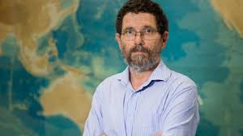
The Great Barrier Reef, Climate Change
and the need for better quality assurance processes in science.
Professor Peter Ridd
Marine Geophysics Laboratory
College of Science and Engineering, James Cook University
Notes:
1

Slide 2
Basic misconception:
The whole world knows that the Great Barrier Reef (GBR) is on its last legs and that it is getting worse.
Mass coral death:
A story constructed to demonstrate the disaster of global warming,
and other human impacts.

Slide 3
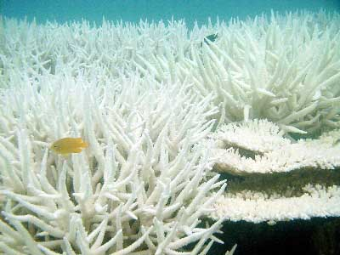
Mass Coral Death
A story made in heaven to demonstrate the disaster of global warming, and other human impacts.
They die in a spectacular way.
Grow back quietly
noaa
Notes:
3

Slide 4
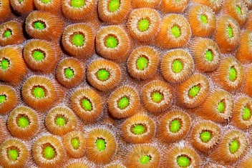
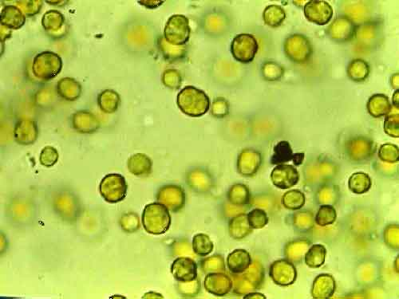
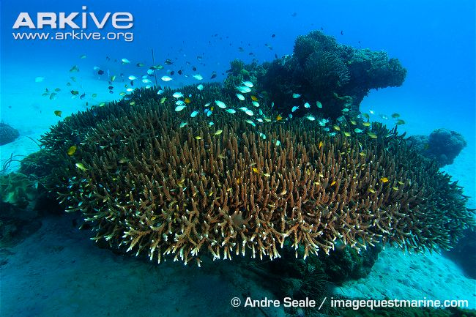
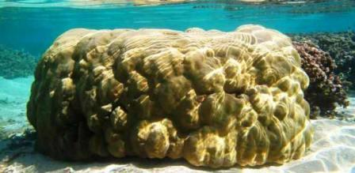
polyp
Zooxanthellae
Robert harding.com
Private-scuba.com
Notes:
A bit of burb on the symbiotic relations ship
4

Slide 5
Corals: A masterpiece of cooperation and Temperature adaptability
When the coral bleaches, the zooxanthellae leave or are ejected by the coral
Coral will bleach from high and low temperature and many other stressful events
Bleaching is not a death sentence, it is a strategy for life
Bleaching often prevents the coral from dying
Corals are born with no zooxanthellae
They capture them from the water and surroundings
Notes:
A bit more on the symbionts and how they can shuffles zooxs to adapt to different temperatures
5

Slide 6
Corals can adept to temperature changes by shuffling zooxanthellae
There are lots of different species of zooxanthellae
Corals have the ability to select zooxanthellae from the water around them
Different species of zooxanthellae affect coral growth rates and their susceptibility to bleaching differently
Some “low octane” species will give resistance to bleaching but corals will grow slowly
“High octane” zooxanthellae will allow the coral to grow quickly but a hotter-than-average year will cause bleaching and possibly even death
After a coral bleaching, the coral may take on a different species of zooxanthellae which will make it less susceptible for temperature in the future
Short lived species like Acropora are more susceptible to bleaching. Live fast, die young and recover quickly.
Massive corals (like Porites) are relatively unaffected by bleaching. They can live for centuries

Slide 7
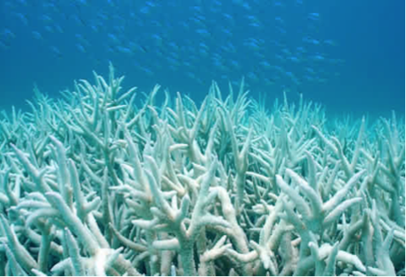
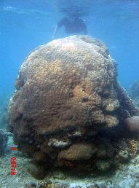
Acropora Corals: The weeds of the reef. Live fast, die young. If bleaching does not kill them, the next cyclone will
Massive corals are relatively unaffected by bleaching or cyclones. They can live for centuries.
Plate and staghorn corals are lucky to survive 20 years The reef is built upon their dead bodies.

Slide 8
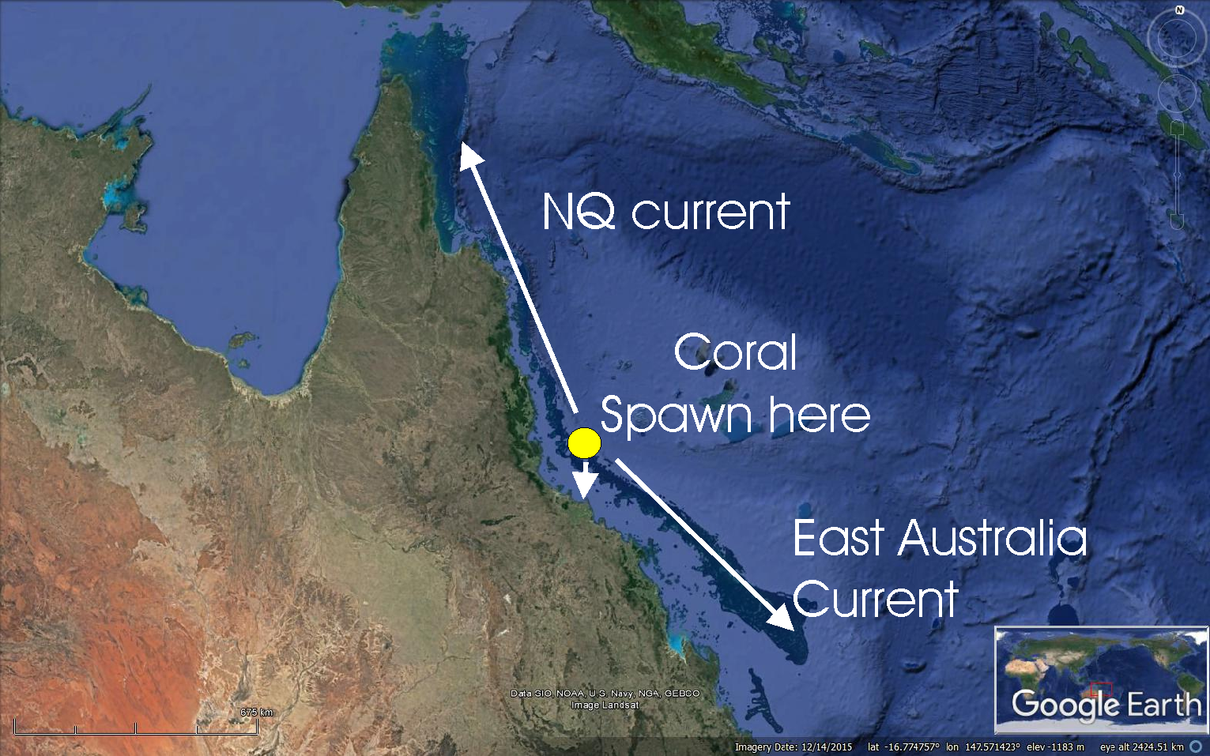
Coral spawn may drift a thousand kilometers into warmer or colder water before it settles and grows.
South – Cold 1-2 ºC
North – Hot 1-2 ºC
Inshore - Hot 1-2 ºC
Shallow - Hot 1-3 ºC
Deep - cold 1-3 ºC

Slide 9
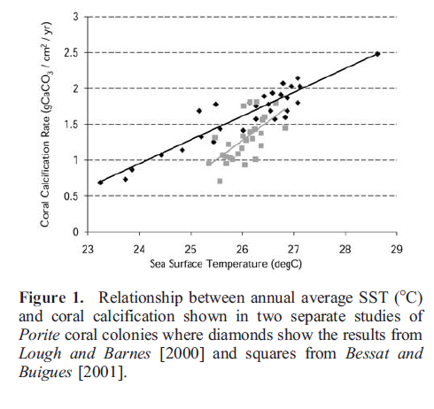
Coral growth rates increase with temperature to well above the average temperature of the GBR.
Almost all corals of the GBR also live around PNG and Thailand where temperature is much hotter
Notes:
Reefs like it hot
9

Slide 10
A major bleaching event occurred in 2016
But the surveys only looked at the shallowest and most susceptible species at water depths of <2 m where water got hottest.
We still have no idea what happened in the deeper water.
Corals grew deeper than -40 m.
For 99% of the corals of the GBR,
there is an 11% increase since the 1940’s
Offshore 11% increase
Mid-shelf 11% increase
Inshore 5% decrease

Slide 11
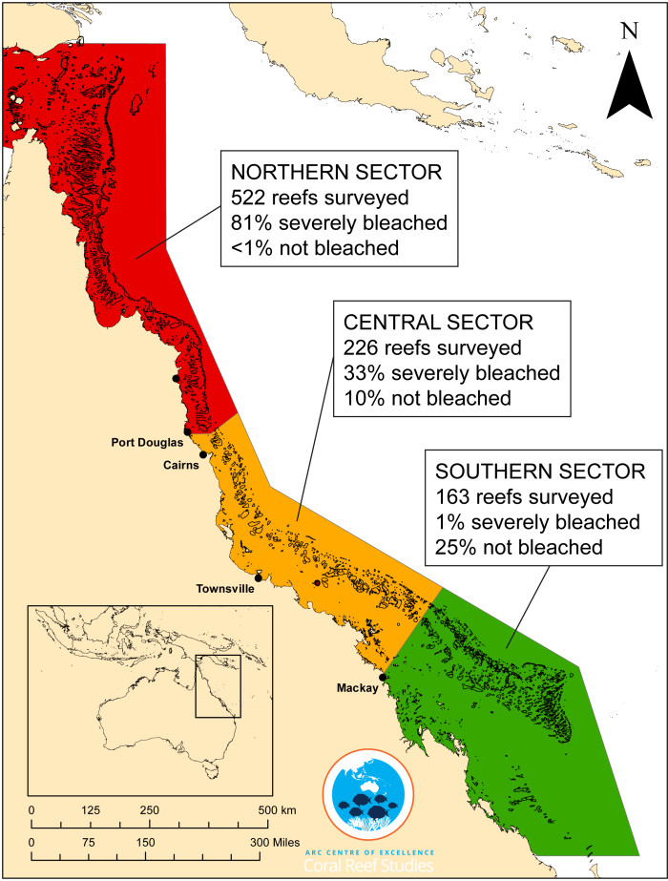
2016 was a major bleaching event But the surveys only looked at the shallowest, and most susceptible coral, i.e. at a water depth of 2 m where the water gets hottest We have no idea what happened in the deeper water. Coral grows deeper than 40 m
Notes:
The survey was badly conceived due to focus on shallow coral and some of the reporting was unfortunate. 93% of reefs bleached does not mean 93% of corals bleached. Also bleaching does not always mean death.
11

Slide 12
Coral Cover on the GBR data: AIMS long term monitoring program
Fluctuates dramatically
Northern GBR at a historic low
Central GBR is doing well
Southern GBR is bouncing back from a historic low coverage caused by TC Hamish
GBR as a whole is about average despite massive bleaching event in the north
For 99% of the corals of the GBR,
there is an 11% increase since the 1940’s
Notes:
Central section boucjnig back after Yasi. Northern sectin crashing
12

Slide 13
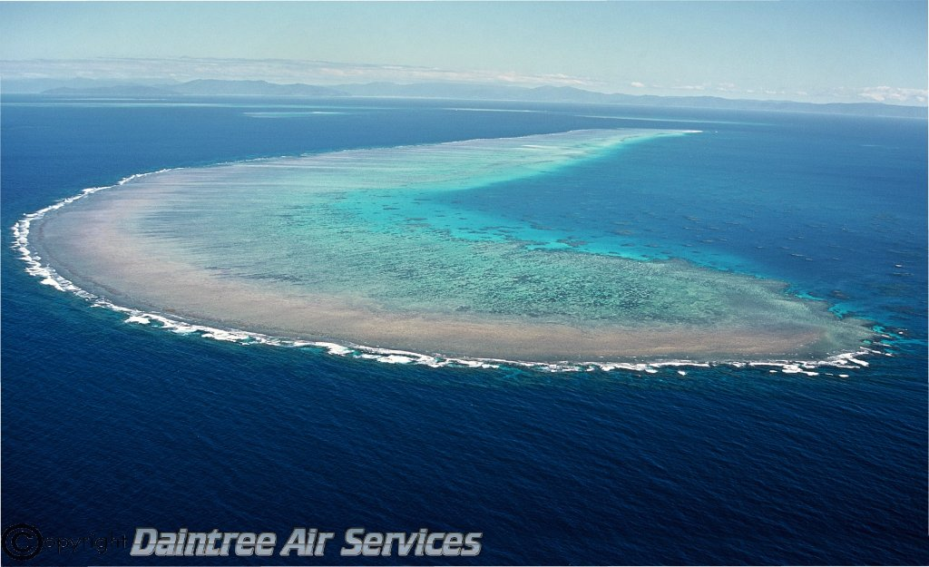
If the sea level rises there will be far more coral on the “reef flats” which were killed by sealevels falling over the last 5000 years
Reef flat

Slide 14
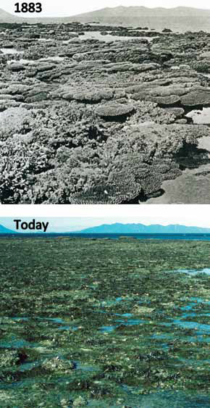
Famous pictures supposedly showing decline of the inshore GBR. We actually can’t be sure where the 1883 picture was taken to better than 2 km. “at a location …near the vicinity of Stone Island”
.

Slide 15
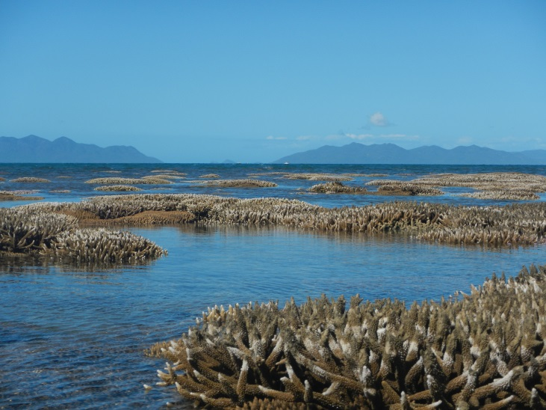
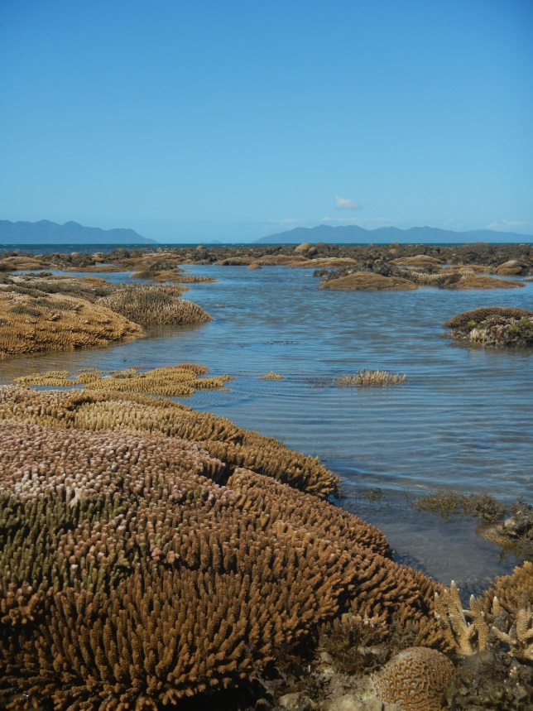
There is beautiful coral “at a location …near the vicinity of Stone Island”
Notes:
The supposition that there is no good coral around Stone Island is simply wrong. Yet more bad science coming from our institution. The big problem is not that they were wrong, but they never checked this work properly. It took my guys one afternoon to show it was all wrong.
15

Slide 16
The Replication Crisis: 50% of recent science literature is wrong
It is not just climate science and GBR science that is corrupted. There is a problem with almost all science except that used by industry.
This gives us a great opportunity to fix the broken scientific quality control systems that plague us.
The replication crisis is recognised by mainstream science organisations.
The replication crisis obviously applies to climate science although the same organisation who accept the replication crisis claim climate science is totally reliable

Slide 17
Conclusion
We must concentrate on using the replication crisis to develop better quality control systems for all of science.
Argue less about the science and more about the systems of quality control.
And don’t worry about the Great Barrier Reef
It is fine !

Slide 18
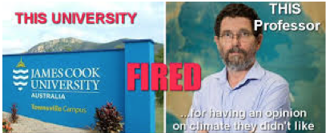
A controversial Australian marine scientist who rejects research showing major human-caused impacts on the Great Barrier Reef has been fired from James Cook University of Queensland, Australia.
The Guardian, May 21, 2018
I have written a couple of times about Peter Ridd. Professor Ridd, a well-published academic whose fields of research include coastal oceanography, reef systems and peer review, has been for ten years the Head of the School of Physics at James Cook University (JCU). When he drew attention to what he saw as exaggerations in the way fellow academics at his university were describing the condition of the Great Barrier Reef he was ‘disciplined’ by JCU, told that he was being uncollegial, and that if he did it again he would be charged with serious misconduct.
Don Aitkin: http://donaitkin.com/the-unfolding-saga-of-peter-ridd/
May I suggest a big round of applause
for this Great Scientist
Please, stand up in honour of our excellent colleague Peter Ridd

