Slide 1
Porto Conference 7-8 September 2018
Portuguese sea level project

Slide 2
Is sea level rise accelerating? Many people says so.
Is it true?

Slide 3
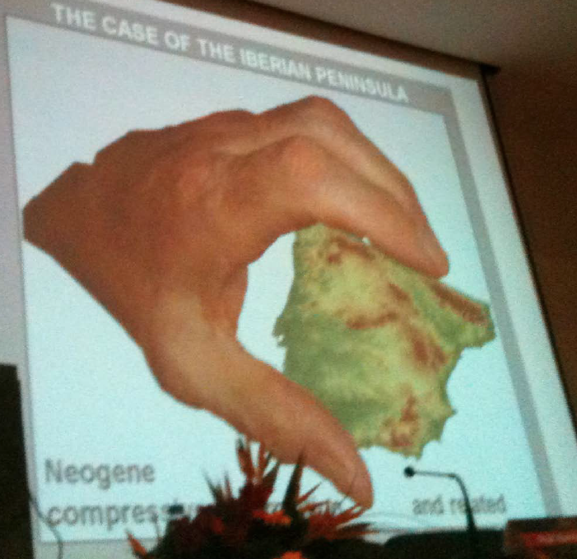
Neogene compression

Slide 4
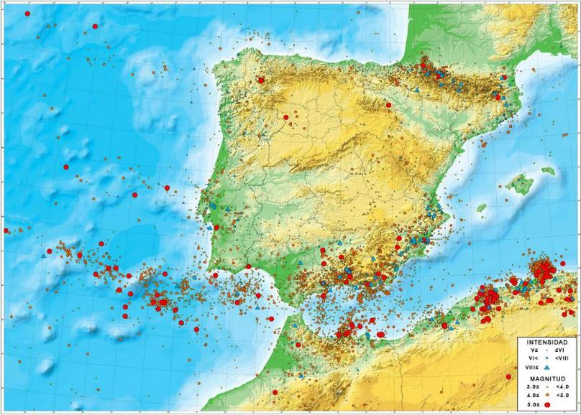
Earthquakes in iberia

Slide 5
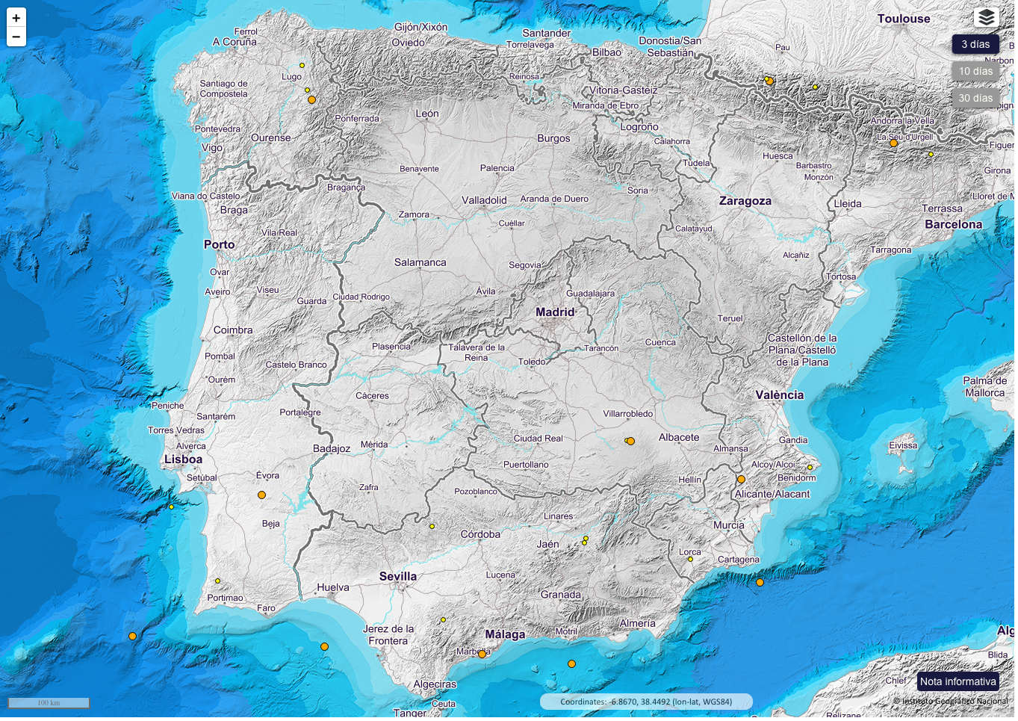
Iberia earthquakes

Slide 6
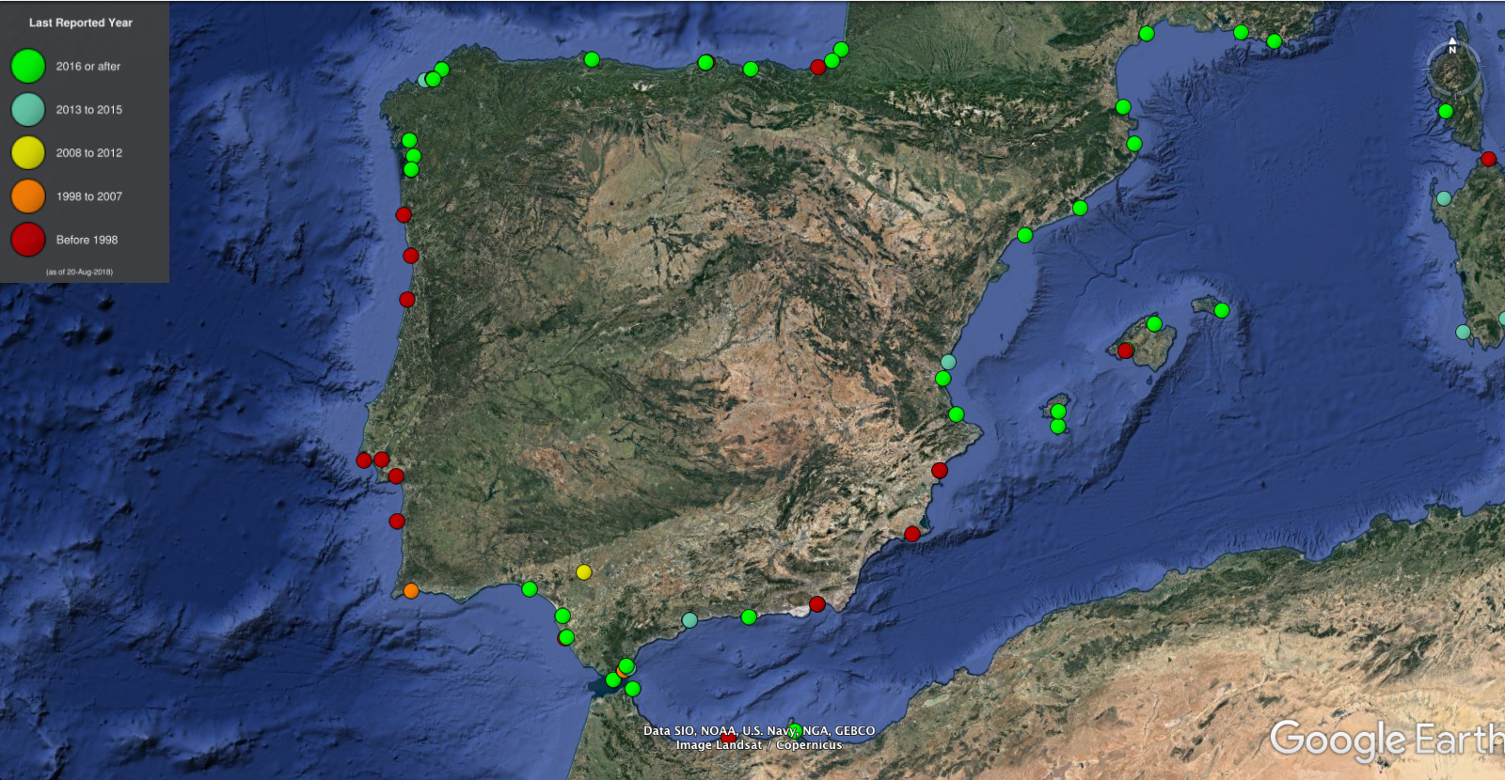
Many PSMSL stations are not updated

Slide 7
Iberia: trends vs. length of series
Portuguese coast

Slide 8
Iberia, in short series: great irregularities in the trends

Slide 9
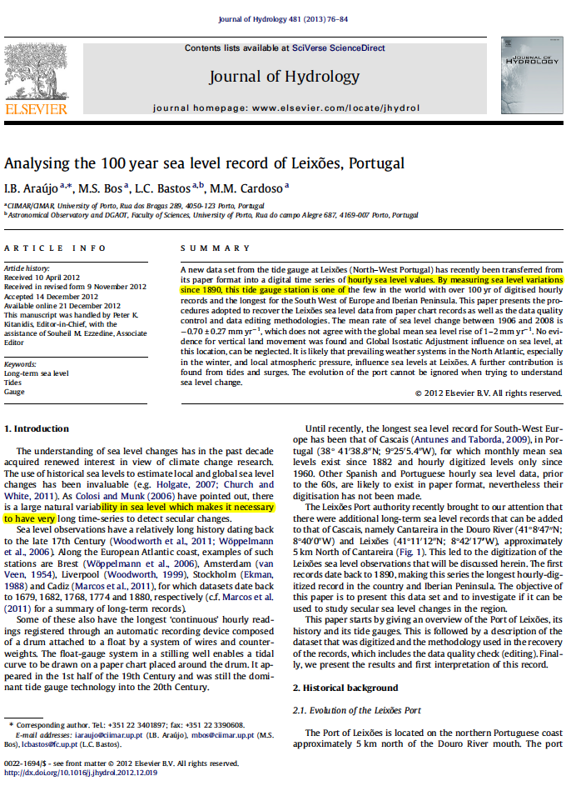
Leixões: one of the longest series
The mean rate of sea level change between 1906 and 2008 is
-0.70 ± 0.27 mm yr

Slide 10
Sea level variation at Leixões (PSMSL)

Slide 11
Cascais: PSMSL data

Slide 12
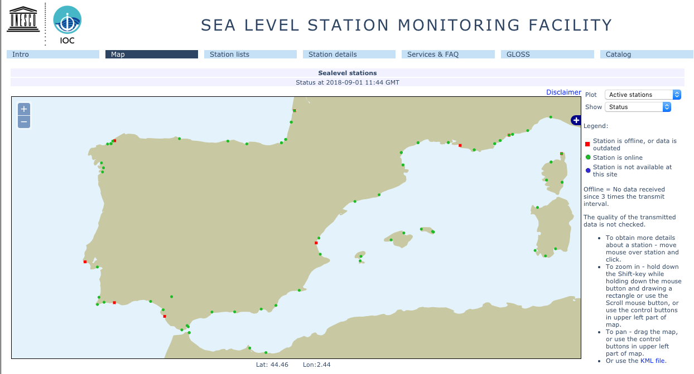
Sea level station monitoring facility

Slide 13
With the data I was able to get one can make this kind of graphs:

Slide 14
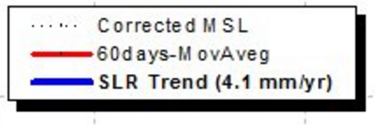
It was used an uplift of 0,5mm/yr

Slide 15
Secular variation of sea level at Cascais

Slide 16
To understand the influence of earth movements: GPS stations

Slide 17
GPS Cascais: vertical velocity

Slide 18
GPS Lagos: vertical velocity

Slide 19
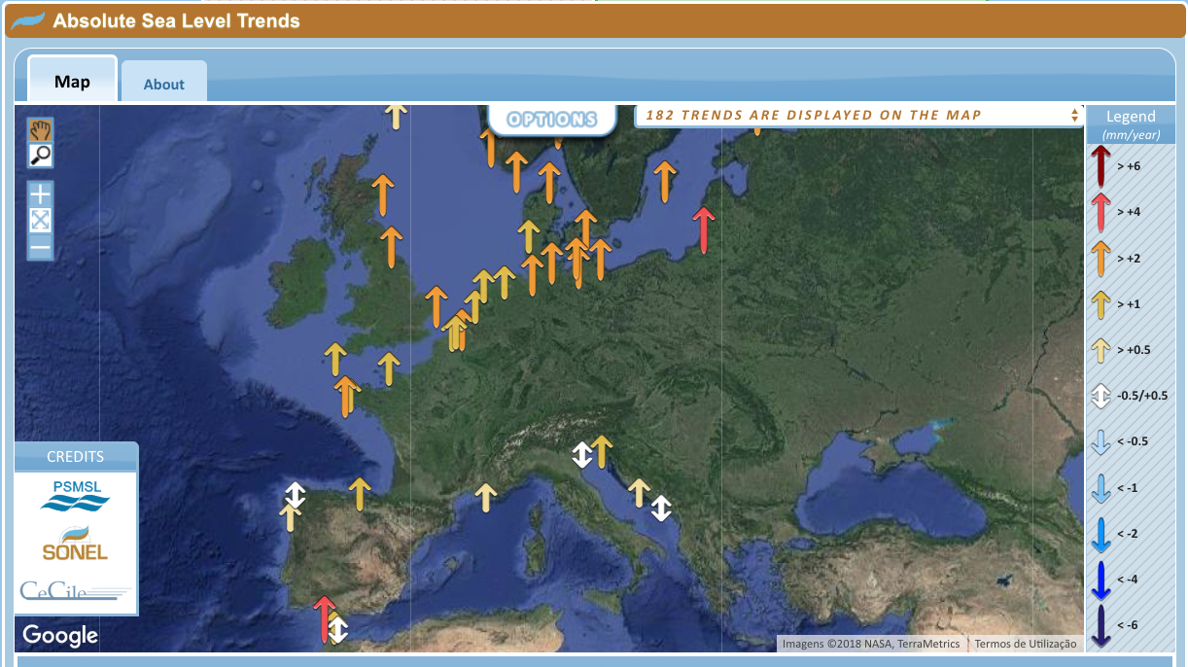
“Absolute” sea level trends

Slide 20
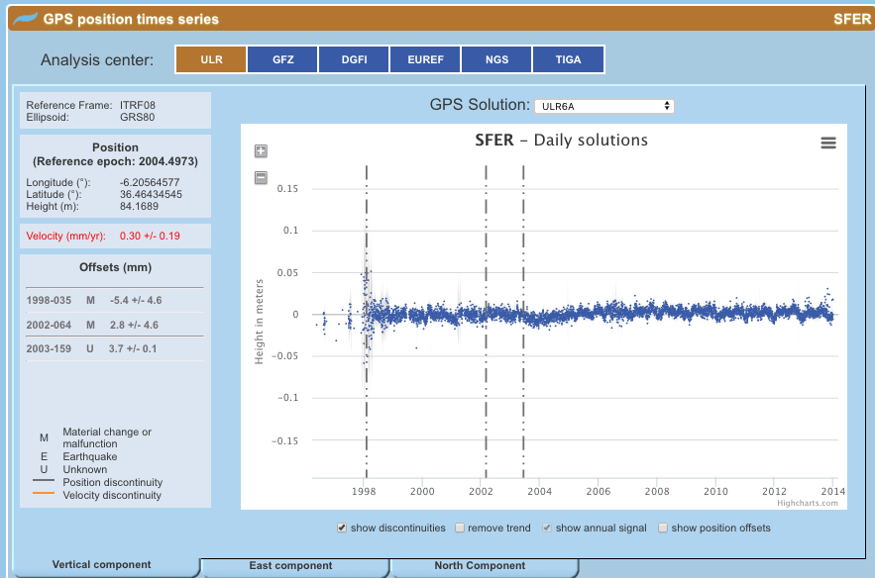

Slide 21
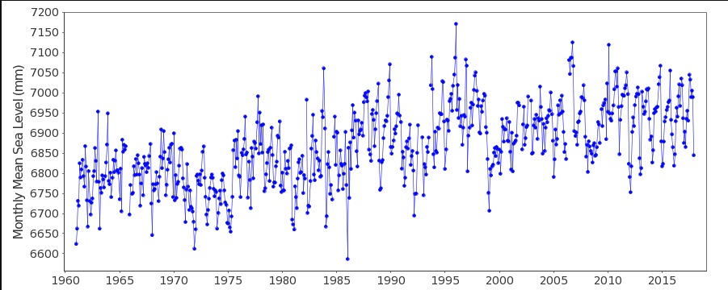
Cádiz: PSMSL data

Slide 23
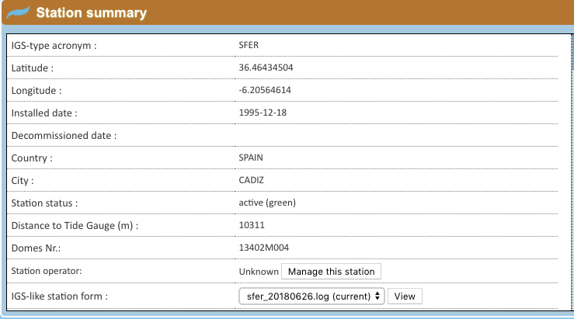
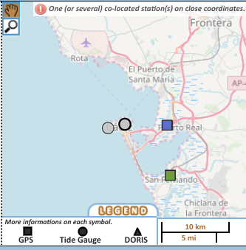

Slide 24
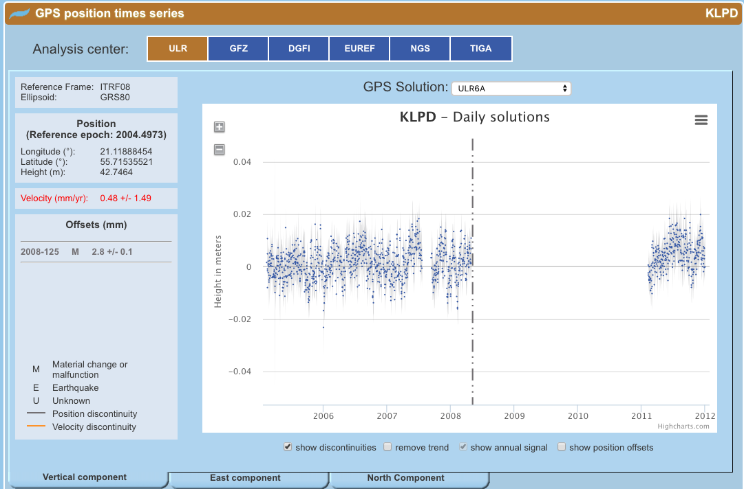

Slide 25
Conclusion: The 2 “red” absolute sea level trends... Are very debatable

Slide 26
May be Niklas is right an a new paradigma is going to emerge....
A diferentiation between North and South of Portugal?
Or just the neotectonic environment?

Slide 27
Thanks for your attention!

