Slide 1
Can we trust time series of historical climate data?
About some oddities in applying standard error propagation laws to climatological measurements
Is an extreme narrow uncertainty band in time series of global temperature trends feasible?
Michael Limburg (EIKE) Porto Conference 7.9.18

Slide 2
What are we talking about
  Fundamentals of metrology (measurement theory) in temperature measurements
  Measurement
  Error treatment
  Combining data: mean & anomaly calculation and time series
  Conclusions

Slide 3
Fundamentals of metrology (measurement theory)
Human reading errors in accuracy and resolution of historical data
Mechanical thermometer resolution
Electronic gauge calibration
Mechanical and Electronic temperature gauge accuracy
Hysteresis (sensitivty) in modern data acquisition
Source: http://wattsupwiththat.com/2011/09/30/gao-report-on-the-poor-quality-of-the-us-climate-monitoring-network/

Slide 4
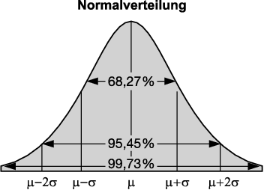
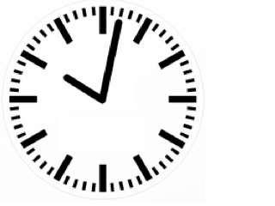
  Error theory
Uncertainty
random
systematic
Coarse (outlier)
Notes:
In der Messtechnik wird häufig eine Normalverteilung angesetzt, die die Streuung der Messfehler beschreibt. Hierbei ist von Bedeutung, wie viele Messpunkte innerhalb einer gewissen Streubreite liegen. Die Standardabweichung ‪σ‬ beschreibt die Breite der Normalverteilung und hängt mit der Halbwertsbreite zusammen. Es gilt näherungsweise:
Im Intervall der Abweichung vom Mittelwert sind 68,27 % aller Messwerte zu finden,
Im Intervall der Abweichung vom Mittelwert sind 95,45 % aller Messwerte zu finden,
Im Intervall der Abweichung vom Mittelwert sind 99,73 % aller Messwerte zu finden.
Und ebenso lassen sich umgekehrt für gegebene Wahrscheinlichkeiten die maximalen Abweichungen vom Mittelwert finden:
50 % aller Messwerte haben eine Abweichung von höchstens ‪0,675σ‬ vom Mittelwert,
90 % aller Messwerte haben eine Abweichung von höchstens ‪1,645σ‬ vom Mittelwert,
95 % aller Messwerte haben eine Abweichung von höchstens ‪1,960σ‬ vom Mittelwert,
99 % aller Messwerte haben eine Abweichung von höchstens ‪2,575σ‬ vom Mittelwert.

Slide 5
Nearly all climatologists assume
  Due to plenty data, random errors will tend to zero
  Anomaly calculation will cancel out most errors of various types (assumption: trends remain the same, local variabilty is decreasing)
  Anomalies of different sources can be combined without problems (f.e. SST and LAT)
  Correlation > 0,5 permit to assume similiar trends

Slide 6
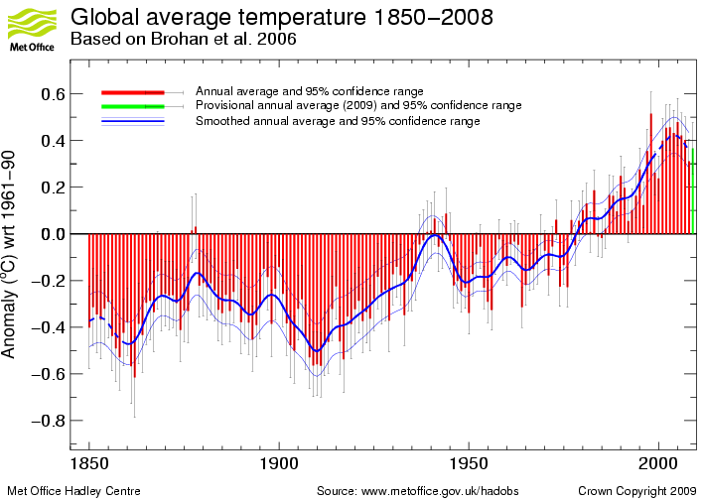
global average temperature time series Hadley CRU CRUTEM the last 150 years
ca. 0,7 °C
* IPCC

Slide 7
Brohan et al 2006„..There will be a difference between the true mean monthly temperature (i.e. from 1 minute averages) and the average calculated by each station from measurements made less often; but this difference will also be present in the station normal and will cancel in the anomaly. So this doesn’t contribute to the measurement error.“(1)
„....reference values computed on smaller [more local] scales over the same time period establishes a baseline from which anomalies are calculated. This effectively normalizes the data so they can be compared and combined to more accurately represent temperature patterns with respect to what is normal for different places within a region.” (2)
1: Brohan, PK,J. J. Harris, I., Tett S. F. B.; & Jones, P. D. (2006) Uncertainty estimates in regional and global observed temperature changes: a new dataset from 1850. HadCRUT 3 HadCRUT 3:1 to 35. page 6
(2) Source: http://www.ncdc.noaa.gov/cmb-faq/anomalies.php paragraph

Slide 8
Hadley Center about SST errors: > 10000 makes them < 0,01 K
  Cite: As noted above, random observational errors are of relatively minor importance in large-scale averages particularly in the modern period when observations are numerous. For an uncertainty of a single observation due to random observational error of 1.0K, the resulting uncertainty of a global annual average based on 10000 (or more) observations would be around 0.01K (or smaller) (1).
Basic Error treatment paper by Brohan 06
  p. 5 cite Folland et a 2001 assumes Measurement error will smaller ± 0.2 °C (1σ) and are random therfore < ± 0,03 °C (Month) Cite from Brohan p 6 The random error in a single thermometer reading is about 0.2°C (1 σ) [Folland et al., 2001]; the monthly average will be based on at least two readings a day throughout the month, giving 60 or more values contributing to the mean. So the error in the monthly average will be at most 0.2/√60 = 0.03◦C and this will be uncorrelated with the value for any other station or the value for any other month. (2)
This means those errors are completely random, sensitivity, autocorrelation etc. do not matter.

Slide 9
True is: Random error reduction of measured data is limited by sensitivty of used tool (see Frank 2010 & 2011).
Also in auto correlated time series data do not follow the standard rules for random (gaussian distribution) error propagation (see M. Massah, H. Kantz1) . They don´t converge to near zero for high numbers of them:
„The uncertainty of a 30y average surface temperature at Potsdam (DEU) is plus minus 0.5 C and at Darwin (AUS) is plus minus 0.4 C. (1)“
(1) Confidence intervals for time averages in the presence of long range correlations, a case study on earth surface temperature anomalies
M. Massah1, H. Kantz1 ⃝c 2016 American Geophysical Union. All Rights Reserved.

Slide 10
Hadley Center about SST errors: > 10000 makes them < 0,01 K
  Cite: As noted above, random observational errors are of relatively minor importance in large-scale averages particularly in the modern period when observations are numerous. For an uncertainty of a single observation due to random observational error of 1.0K, the resulting uncertainty of a global annual average based on 10000 (or more) observations would be around 0.01K (or smaller) (1).
Basic Error treatment paper by Brohan 06
  p. 5 cite Folland et a 2001 assumes Measurement error will smaller ± 0.2 °C (1σ) and are random therfore < ± 0,03 °C (Month) Cite from Brohan p 6 The random error in a single thermometer reading is about 0.2°C (1 σ) [Folland et al., 2001]; the monthly average will be based on at least two readings a day throughout the month, giving 60 or more values contributing to the mean. So the error in the monthly average will be at most 0.2/√60 = 0.03◦C and this will be uncorrelated with the value for any other station or the value for any other month. (2)
This assumptions requires those errors are completely random, sensitivity, autocorrelation etc. do not matter. But this is wrong!!!
Source Uncertainty in historical SST data sets http://www.metoffice.gov.uk/hadobs/hadsst3/uncertainty.html
(2) „Uncertainty estimates in regional and global observed temperature changes: a new dataset from 1850“ P. Brohan, J. J. Kennedy, I. Harris, S. F. B. Tett & P. D. Jones

Slide 11
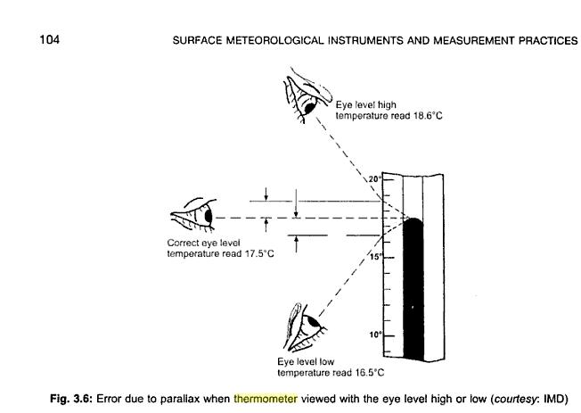
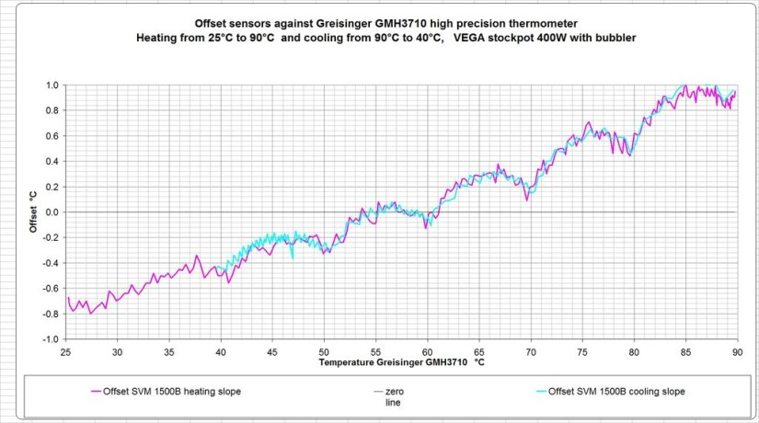
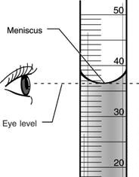
  Measurement errors
Mercury forms a pronounced meniscus in a thermometer that can exceed 1c
Shown is an alcohol liquid
Source: Image courtesy of Surface meteorological instruments and measurement practices By G.P. Srivastava (with a mercury meniscus!)
More details here:http://wattsupwiththat.com/2011/01/22/the-metrology-of-thermometers/
Notes:
If you are using data from 100′s of thermometers scattered over a wide area, with data being recorded by hand, by dozens of different people, the observational resolution should be reduced. In the oil industry it is common to accept an error margin of 2-4% when using manually acquired data for example.
Glass thermometers are calibrated by immersing them in ice/water at 0c and a steam bath at 100c. The scale is then divided equally into 100 divisions between zero and 100. However, a glass thermometer at 100c is longer than a thermometer at 0c. This means that the scale on the thermometer gives a false high reading at low temperatures (between 0 and 25c) and a false low reading at high temperatures (between 70 and 100c) This process is also followed with weather thermometers with a range of -20 to +50c
25 years ago, very accurate mercury thermometers used in labs (0.01c resolution) had a calibration chart/graph with them to convert observed temperature on the thermometer scale to actual temperature.
Temperature cycles in the glass bulb of a thermometer harden the glass and shrink over time, a 10 yr old -20 to +50c thermometer will give a false high reading of around 0.7cOver time, repeated high temperature cycles cause alcohol thermometers to evaporate vapour into the vacuum at the top of the thermometer, creating false low temperature readings of up to 5c. (5.0c not 0.5 it’s not a typo…)
Electronic temperature sensors have been used more and more in the last 20 years for measuring environmental temperature. These also have their own resolution and accuracy problems. Electronic sensors suffer from drift and hysteresis and must be calibrated annually to be accurate, yet most weather station temp sensors are NEVER calibrated after they have been installed. drift is where the recorder temp increases steadily or decreases steadily, even when the real temp is static and is a fundamental characteristic of all electronic devices.
Drift, is where a recording error gradually gets larger and larger over time- this is a quantum mechanics effect in the metal parts of the temperature sensor that cannot be compensated for typical drift of a -100c to+100c electronic thermometer is about 1c per year! and the sensor must be recalibrated annually to fix this error.Hysteresis is a common problem as well- this is where increasing temperature has a different mechanical affect on the thermometer compared to decreasing temperature, so for example if the ambient temperature increases by 1.05c, the thermometer reads an increase on 1c, but when the ambient temperature drops by 1.05c, the same thermometer records a drop of 1.1c. (this is a VERY common problem in metrology)
a -20c to +50c mercury thermometer packaging will state the accuracy of the instrument is +/-0.75c for example, yet frequently this information is not incorporated into statistical calculations used in climatology.

Slide 12
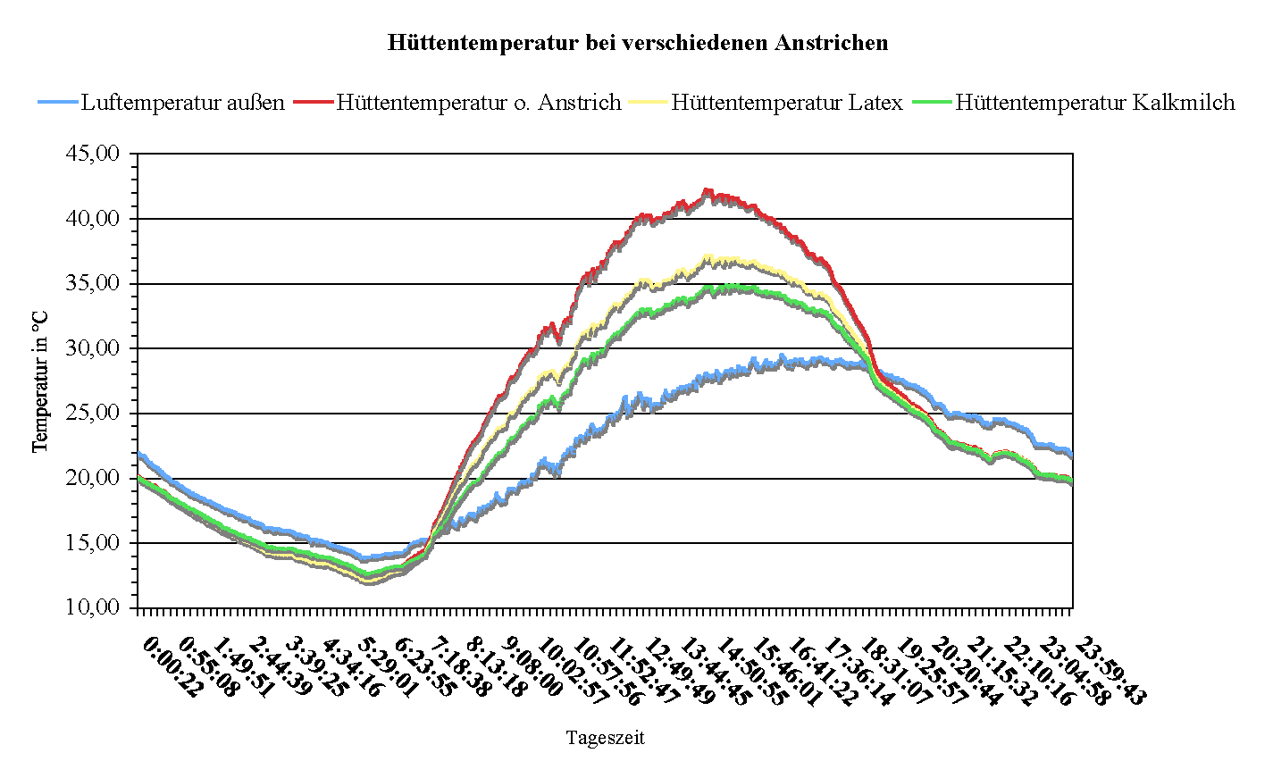
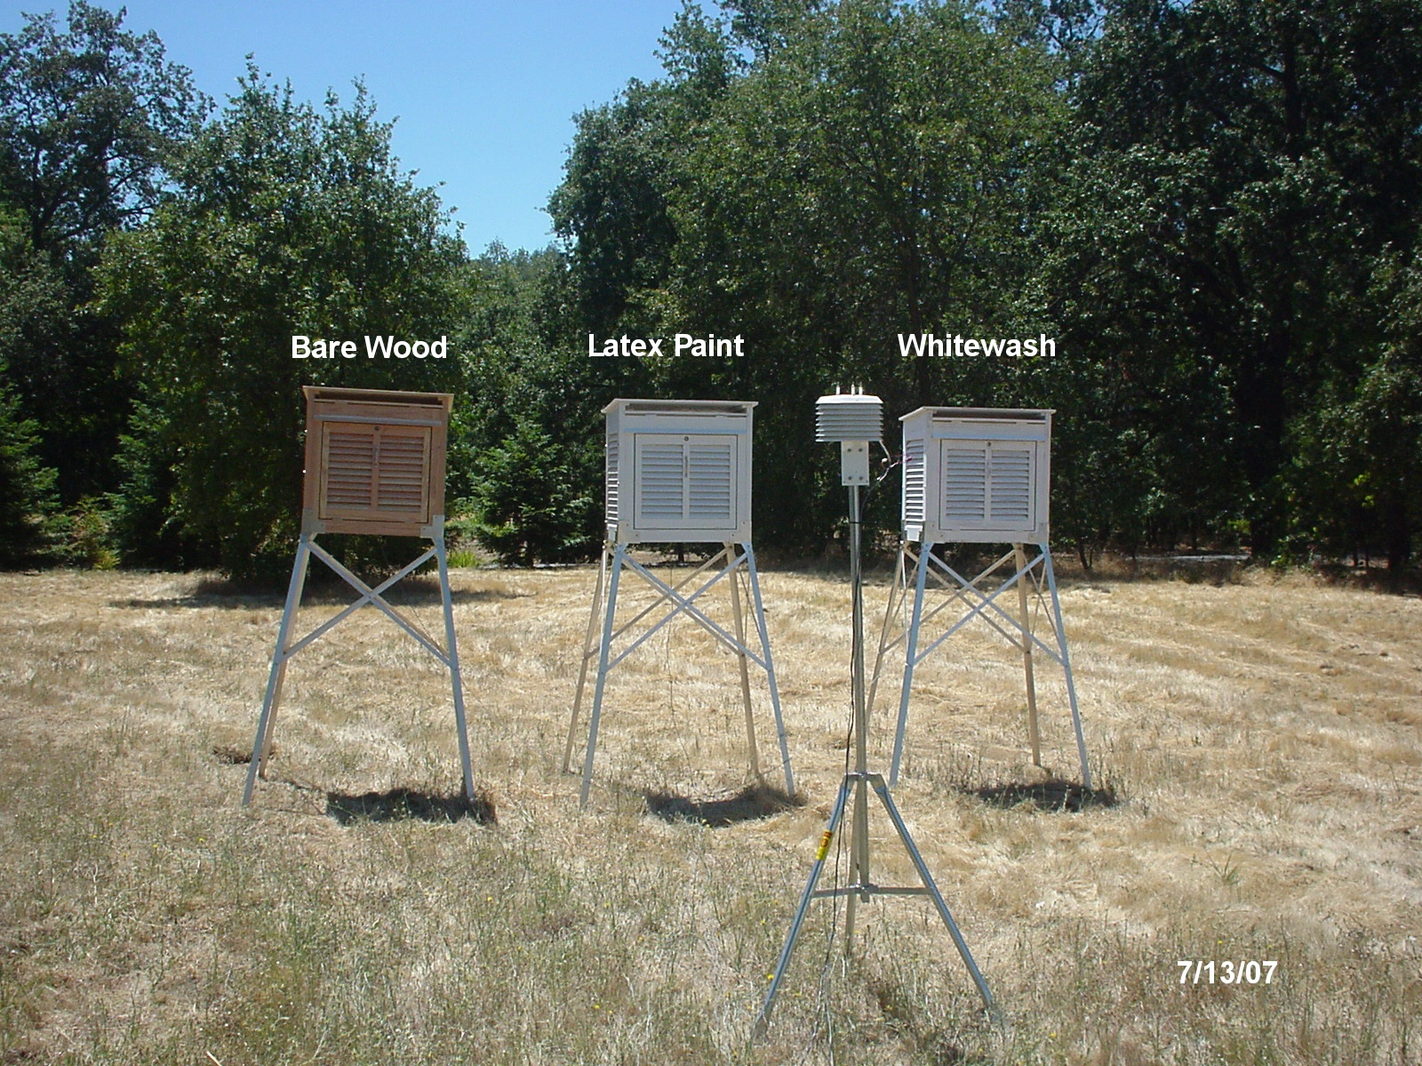
Which air temperature do we measure
  True air temperatur?
  Inner temperature of a weather station?

Slide 13
Facts are:
  Measurement experts: The resolution of an astute and dedicated observer would be around +/-0,5 °C.
  Folland et al (2001) estimate measurement errors (1σ) with max. ± 0.2 °C
  Other systematic errors are adding up

Slide 14
Brohan et al 2006„..There will be a difference between the true mean monthly temperature (i.e. from 1 minute averages) and the average calculated by each station from measurements made less often; but this difference will also be present in the station normal and will cancel in the anomaly. So this doesn’t contribute to the measurement error.“(1)
„“....reference values computed on smaller [more local] scales over the same time period establishes a baseline from which anomalies are calculated. This effectively normalizes the data so they can be compared and combined to more accurately represent temperature patterns with respect to what is normal for different places within a region.” (2)
1: Brohan, PK,J. J. Harris, I., Tett S. F. B.; & Jones, P. D. (2006) Uncertainty estimates in regional and global observed temperature changes: a new dataset from 1850. HadCRUT 3 HadCRUT 3:1 to 35. page 6
(2) Source: http://www.ncdc.noaa.gov/cmb-faq/anomalies.php paragraph

Slide 15
Influence of sudden errors
mean temperature w error
„errorfree“ mean temperature
Notes:
1940 trat ein systematischer Fehler von + 1k auf

Slide 16
Influence of sudden error
errorfree anomaly
Anomaly with error
Trend 2
Trend 1
Notes:
1940 trat ein systematischer Fehler von + 1k auf

Slide 17
Influence of sudden errors 2
Anomaly with error
errorfree anomaly
Trend 2
Trend 1
„errorfree“ anomaly
Notes:
Der systematische Sprungfehler von +1 K trat hier ab 1980 – also im Referenzeitraum auf.

Slide 18
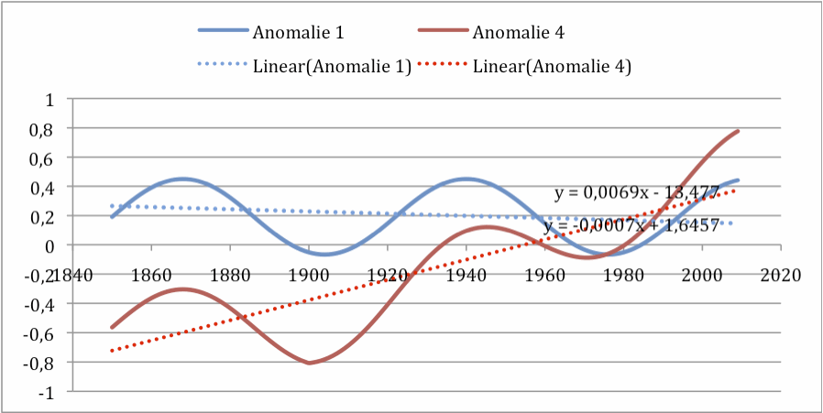
Creeping error

Slide 19
Conclusion 1
Anomaly calculation do not cancel out systematic errors in general
Only in one single case!
  Same error exists over whole period examined
Therefore they have to be determined or estimated
  And corrected or indicated

Slide 20
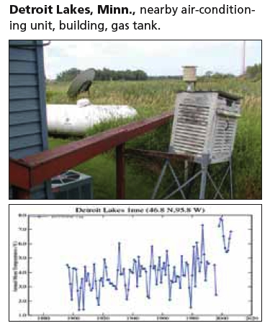
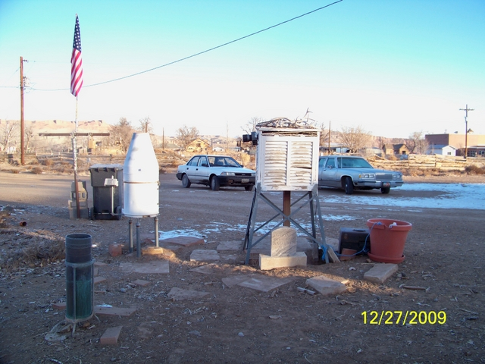
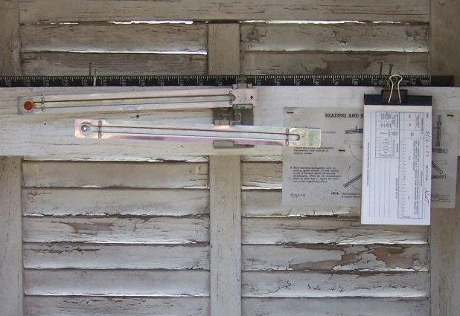
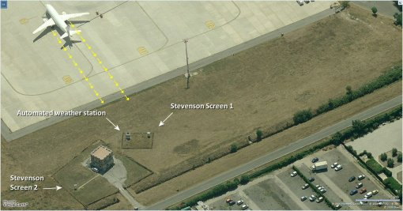
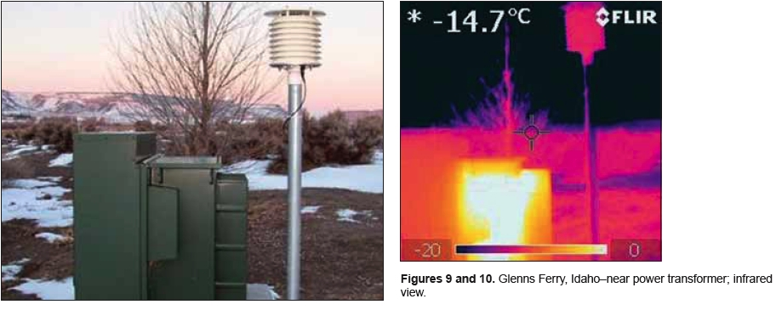
Source of most images Is the U.S. Temperature Record Reliable? By A. Watts

Slide 21
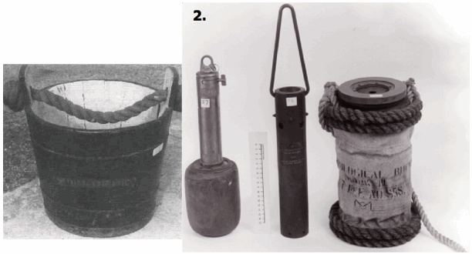
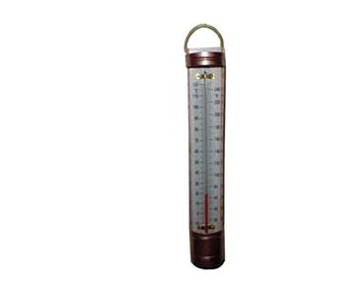
Land based measurement
SST measurement
Oceans cover 71 % of earth surface

Slide 22

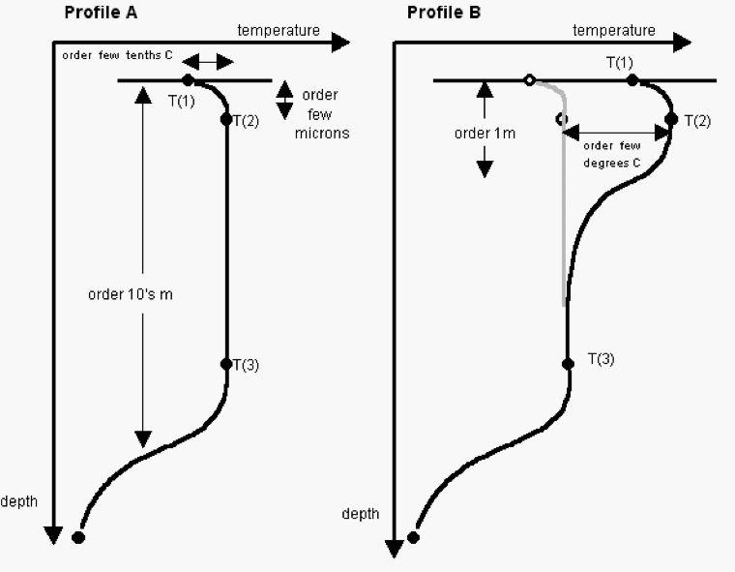
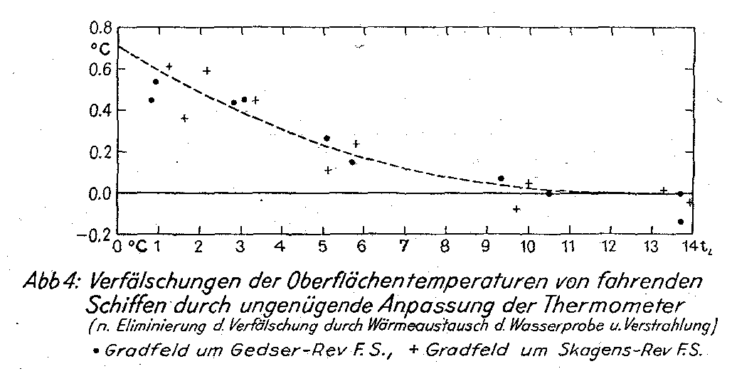
Notes:
More problems: No fixed position, nor height, nor depth. Pseudo randomly distributed into any grid. Few grids are oversampled, most grids are undersampled dwon to zero.

Slide 23
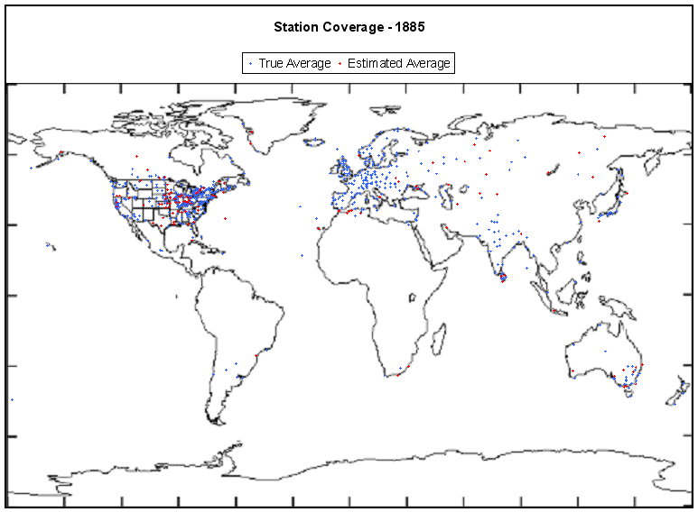
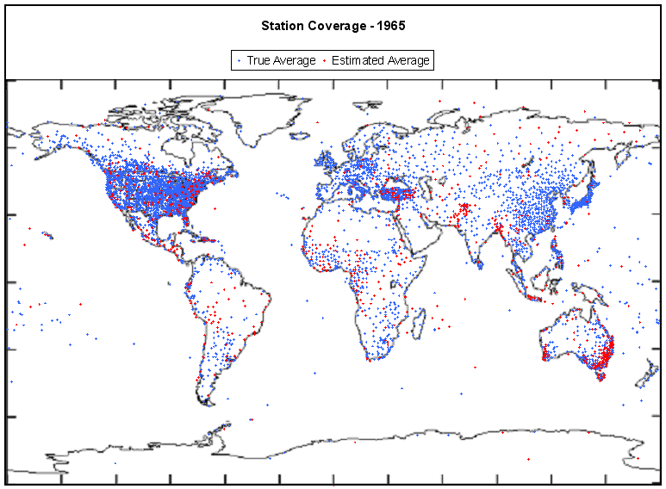
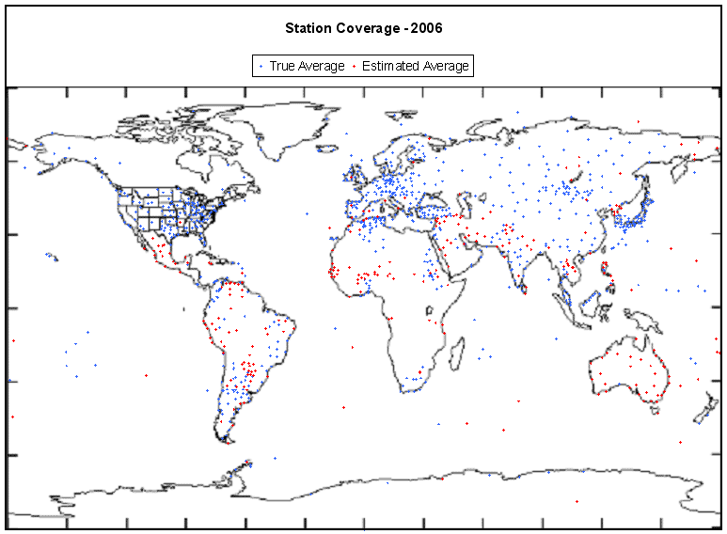
Distribution of measurement stations (land)*
Coverage and number of GHCN stations word wide 1860-2006
Only few % of earth surface are covered
  By far most in develloped countries in NH
Sea surface see next image
*Aussage Met-Office = DWD
Quelle: http://climateaudit.org/2008/02/10/historical-station-distribution/
Notes:
Das Metoffice behauptet auf seiner Website: Thermometers „..are evenly distributed“. Das ist falsch: Es gibt eine Wanderung und Auslöschung der Thermometer: Bild 1 Zahl der einbezogenen nicht unbedingt kontinuierlich messenden Stationen (in tausend) , bis 1970 Zunahme, dann ab 1989 starke Abnahme. Alles Zufall? Blau kontinuierlich messend. Rot diskontinuierlich messend. Trends von diesen Stationen geschätzt. Keine Grundlage für naturwissenschaftlich basierte Statistik.. Nächste Folie nochmals genauer!
Stationsverteilung von 2006, Fehlende Messungen in sehr, sehr großen Teilen der Welt. Arktis nicht, Antarktis nichts, Südamerika, Afrika, Australien und Asien sehr wenig Stationen. Aber dort Positivauswahl erfolgt; bestätigt für wenige & „warme“ Stationen. > 50 % der Stationen (2010) liegen auf Flughäfen, ca. 80 % in Ballungsgebieten und/oder Flughäfen

Slide 24

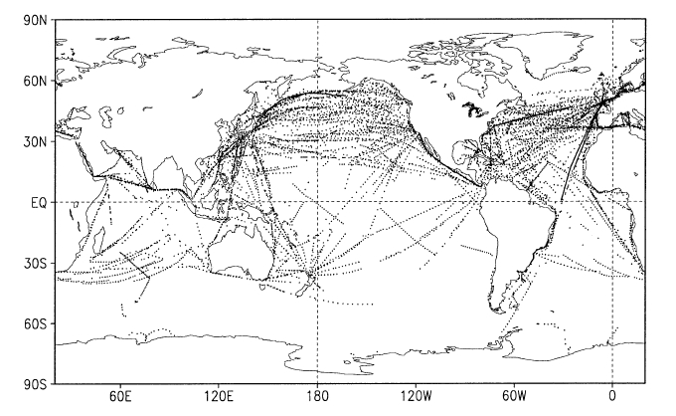
Distribution of measurement ships 2000 (sea)

Slide 25
Puchberg station* : Comparison of mean algorithms over 9 years
*Source Aguilar, 2003

Slide 26
name of error | app.min. magnitude in K | kind of error
Min. measurement, reading errror and normal introduced uncertainty (P. Frank 2010(2), 2011(3)) | ± 0,98 | σ = ±0.49 C (1). The 95% confidence interval of these uncertainties alone equals ±0.98 C, discounting the entire global surface air temperature anomaly trend between 1856 and 2004. (before claimed as acc. Folland et al 2001(4) only random with ± 0,2 K); act as systematic
Painting error latex vs. whitewash | + 0,2 | Systematic; permanent; starts from ca. 1980
Instrumental change | + 0,2 | Systematic; erratic starts from ca. 1975
Height variation of Screens | ± 0,2 | Systematic; erratic but permanent
Sourrounding changes, f.e changes of direct ambient conditions . asphalt; parking lots etc. | + 0,3 | Systematic; creeping, starting point vague
UHI incl. changed land use | + 0,4 bis + 0,8; 0 +0,5 | Systematic; creeping, from 1900 with 0,6 K at end of 20th Ende century
Diff. Averaging algorithms | + 0,2-0,3 | Systematic; permanent
SST vs. MAT | +0,2 to 0,7 | Systematic; permanent
Poor area coverage land as well as sea | + 0,5 | mean, systematic permanent, in the past much greater than today.
* 1 𝛔
1 sigma uncertainty in yearly anomaly referenced to a 30 year mean.
2 Patrick Frank. UNCERTAINTY IN THE GLOBAL AVERAGE SURFACE AIR TEMPERATURE INDEX: A REPRESENTATIVE LOWER LIMIT Energy & Environment · Vol. 21, No. 8, 2010
3 Patrick Frank IMPOSED AND NEGLECTED UNCERTAINTY IN THE GLOBAL AVERAGE SURFACE AIR TEMPERATURE INDEX, Energy & Environment · Vol. 22, No. 4, 2011
4 Folland, C.K., Rayner, N.A., Brown, S.J., Smith, T.M., Shen, S.S.P., Parker, D.E., Macadam, I., Jones, P.D., Jones, R.N., Nicholls, N. and Sexton, D.M.H., Global Temperature Change and its Uncertainties Since 1861, Geophys. Res. Lett., 2001, 28(13), 2621-2624.

Slide 27
Conclusion 2
Systematic biases and sources of errors are plenty
Lots of them contaminate strongly all data and must be identified & determined
  either corrected
    only done in few cases
  or indicated
The existing timeseries lag of precise error ranges

Slide 28
global average temperature time series Hadley CRU the last 150 years
* IPCC

Slide 29
ca. 4 °C

Slide 30
Conclusion 3
the calculated mean lies anywhere in a much wider uncertainty band
any attribution of potential causation to changes of that numbers are therefore speculative
global average temperature anomalies are specific numbers only
Only good news are: Oscillating forces are not affected!

Slide 31
Tank you very much for listening!

