Slide 1
Karl Zeller & Ned Nikolov
Independent Researchers
Fort Collins CO, USA
Earth + Solar System Data
& Scientific Method =
New Climate Science

Slide 2
Do we want to ‘bring light to’, ‘correct’ and/or ‘replace’ the errors of the current dominant Green House Gas theory?

Slide 3
Would sound, hard physical evidence be useful in our endeavor to replace the GHG theory?

Slide 4
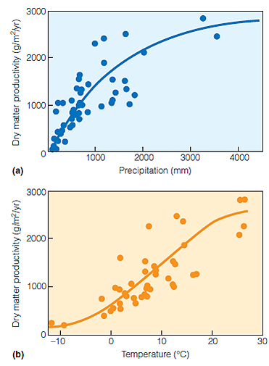
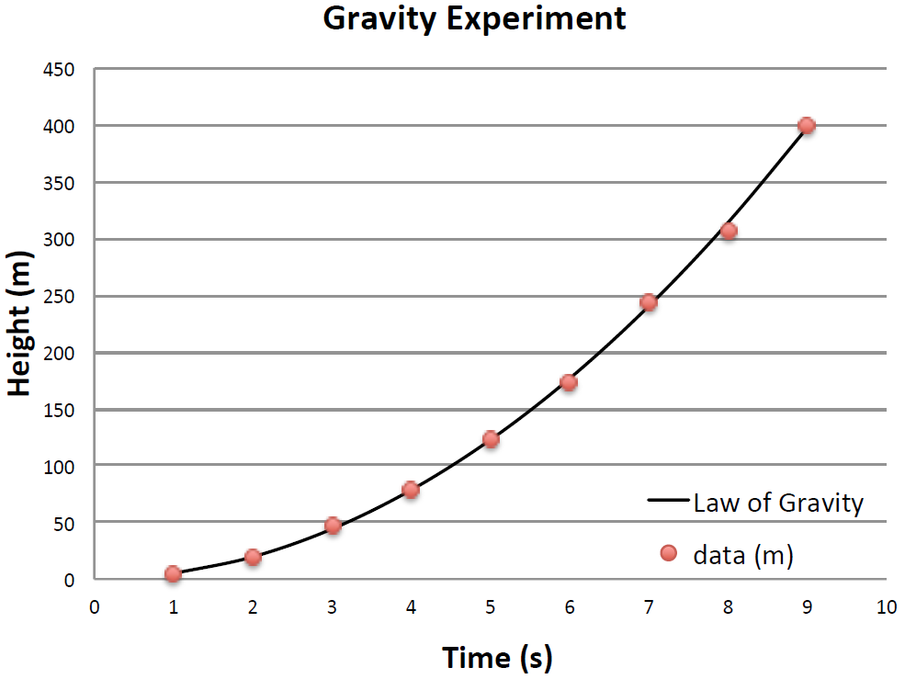
Correlative Relationships vs. Physical Laws

Slide 5
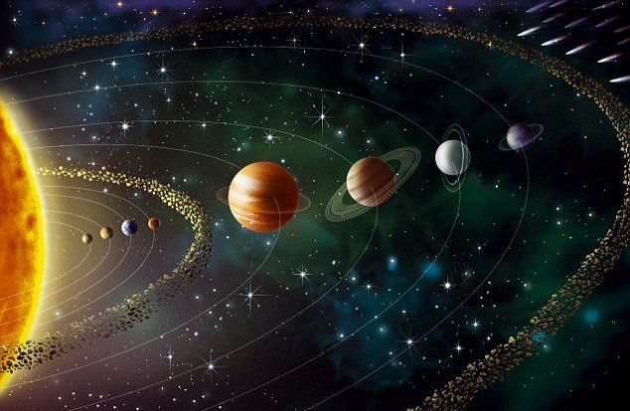
Consider Earth’s climate from afar: The Copernicus Approach!
Might the same physical principles determine the global temperatures (𝑇s) of Venus, Earth, Mars, Titan and Triton? In other words, is Earth a special case in terms of its climate, or is it a part of a Physical Cosmic Continuum?
2. What are the main universal controllers of the equilibrium global average surface temperature of a planet or moon?

Slide 6
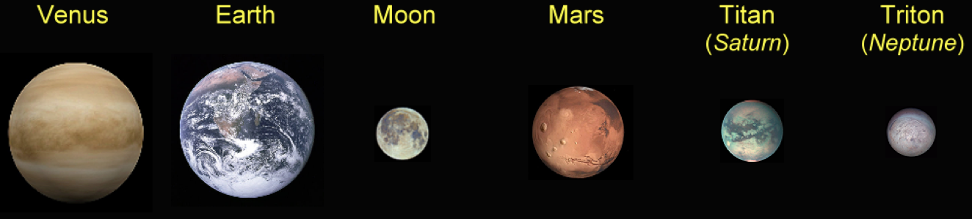
Use/study/analyze NASA data observed/collected from planets & moons with solid/liquid surfaces (not gaseous) in our solar system

Slide 7
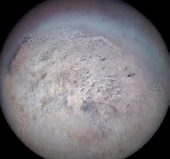
TRITON
Sun Distance 30.07 Au
Sun Energy 1.5 Wm⁻²
Albedo 0.650
P_{s} 4.0 Pa
% Composition
99.91 N₂
0.060 CO
0.024 CH₄
Ts 39.0 K
Te (emission temp) 39.2 K
Tna (airless temp) 35.9 K
Ts / Te 0.994
Ts / Tna 1.086
The Ts / Tna ratio is a measure of the warming effect of having an atmosphere, Hence 1.086 means Triton’s mean global temperature is 8.6% warmer than it would be without an atmosphere.

Slide 8
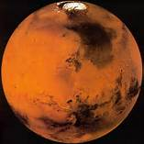
MARS
Sun Distance 1.5237 Au
Sun Energy 586.2 Wm⁻²
Albedo 0.235
P_{s} 685.4 Pa
% Composition
95.32 CO₂
2.70 N₂
1.60 Ar
0.13 O₂
0.08 CO
0.021 H₂O
Ts 190.6 K
Te 211.9 K
Tna 159.6 K
Ts / Te 0.899
Ts / Tna 1.194

Slide 9
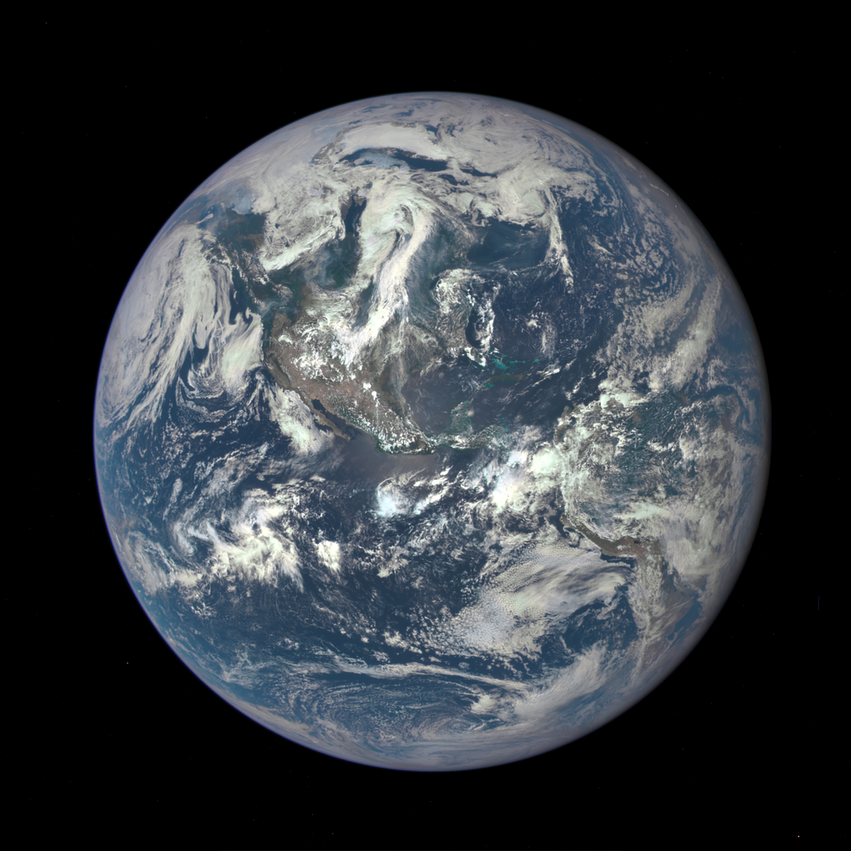
EARTH
Sun Distance 1.0 Au
Sun Energy 1,361 Wm⁻²
Albedo 0.294
P_{s} 98,550 Pa
= 14.29 # ft⁻²
% Composition
77.89 N₂
20.89 O₂
0.932 Ar
0.248 H₂O
0.040 CO₂
Ts 287.4 K
= 57.6 F
Te 256.4 K
Tna 197 K
= -105.1 F
Ts / Te 1.12
Ts / Tna 1.46
Here Ts / Tna, the ratio that measures of the warming effect of having an atmosphere, Earth’s mean global temperature is 46% warmer than it would be without an atmosphere.

Slide 10
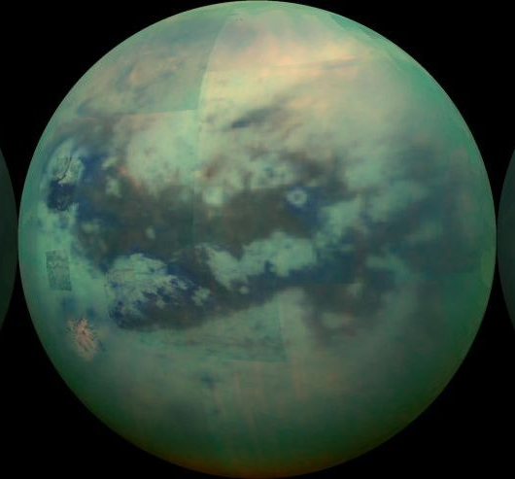
TITAN
Sun Distance 9.582 Au
Sun Energy 14.8 Wm⁻²
Albedo 0.265
P_{s} 146,700 Pa
% Composition
95.1 N₂
4.9 CH₄
Ts 93.7 K
Te 83.6 K
Tna 63.6 K
Ts / Te 1.120
Ts / Tna 1.473

Slide 11
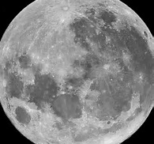
MOON
Sun Distance 1.0 Au
Sun Energy 1,360.9 Wm⁻²
Albedo 0.136
P_{s} 2.96×10⁻¹⁰ Pa
% Composition
26.7 ⁴He
26.7 ²⁰Ne
23.3 H₂
20.0 ⁴⁰Ar
3.3 ²²Ne
Ts 197.3 K
Te 269.7 K
Tna 197 K
Ts / Te 0.73 K
Ts / Tna 1.00 K

Slide 12
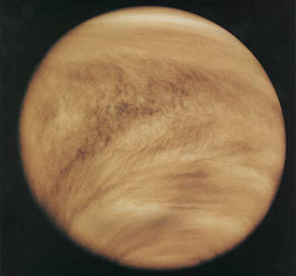
VENUS
Sun Distance 0.7233 Au
Sun Energy 2601 Wm⁻²
Albedo 0.90
P_{s} 9,300,000 Pa
% Composition
96.5 CO₂
3.48 N₂
0.02 SO₂
Ts 737 K
Te 185 K
Tna 232 K
TsTe 3.985
TsTna 3.181

Slide 13
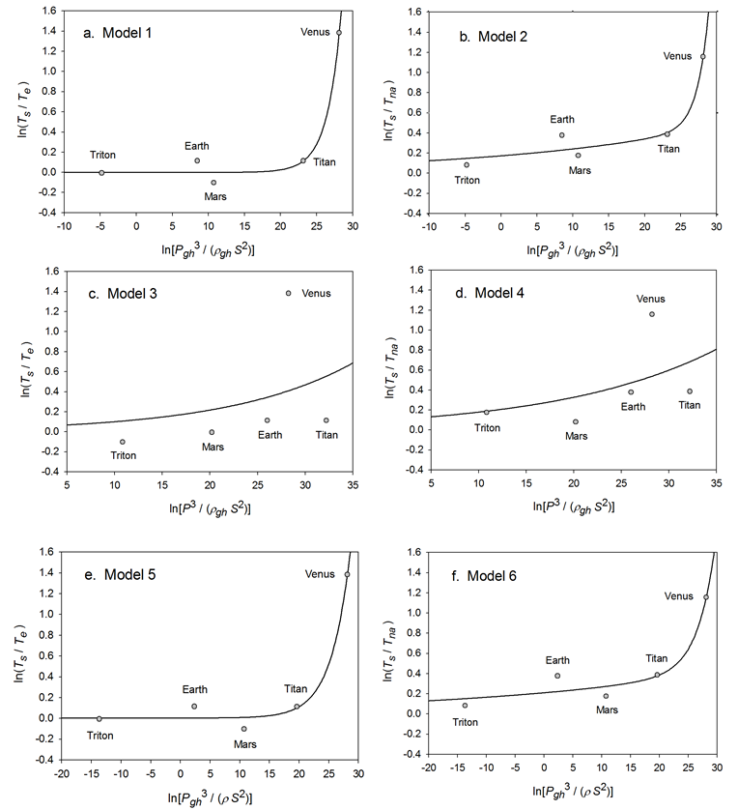
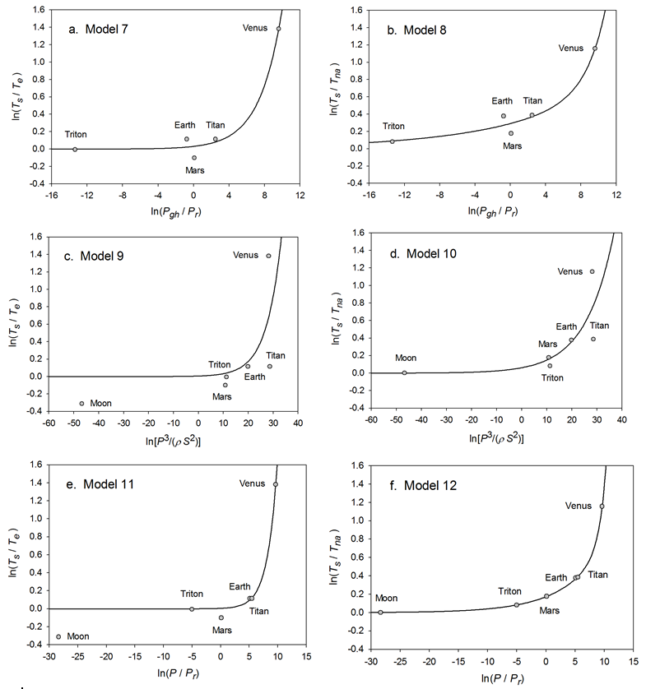
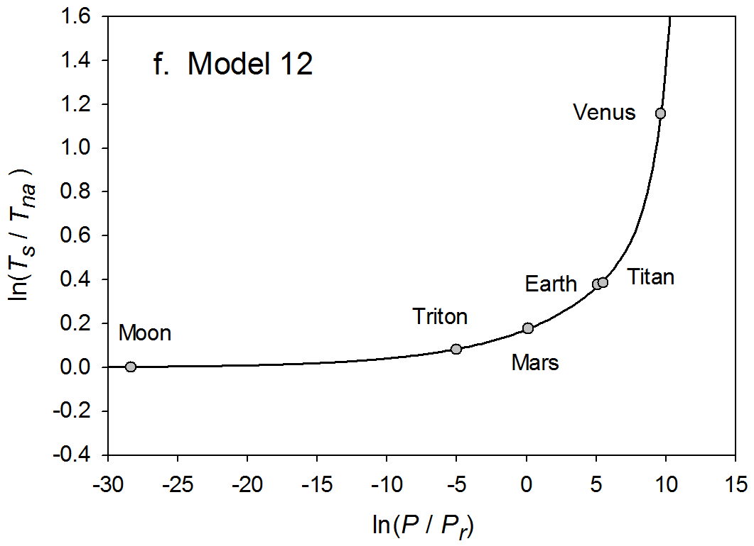
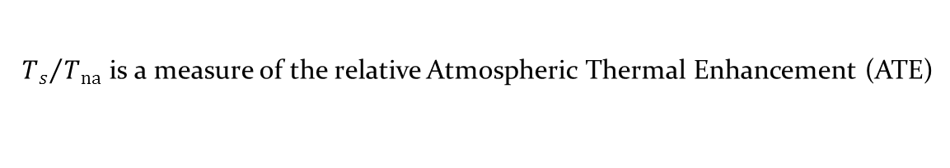
Ex: 12 regression studies employing NASA DATA
${T_{s}}/{T_{na}}$ is a measure of the relative Atmospheric Thermal Enhancement (ATE)

Slide 14
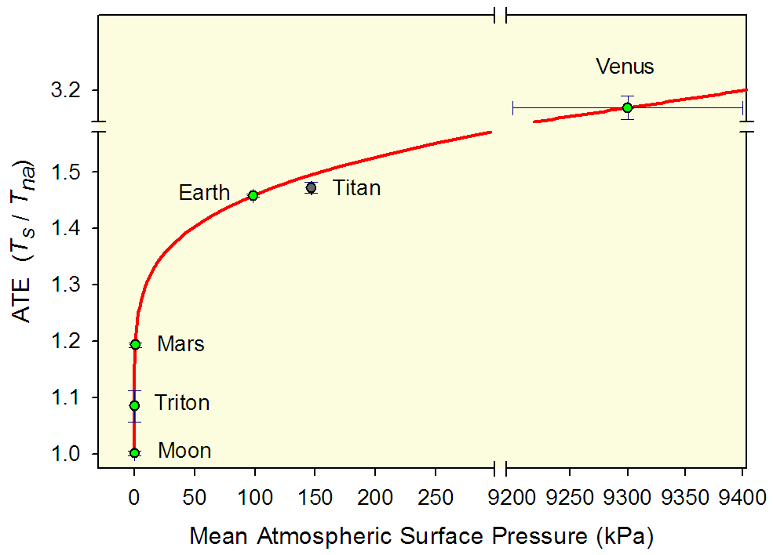
Linear Plot of the T_{s} - P Relationship
The ratio Ts / Tna is a measure of the amount (%) of thermal enhancement experienced by an atmosphere due to the pressure generated by gravity’s effect on the air molecules. We call this the ATE: atmospheric thermal effect.
ATE is the true ‘greenhouse’ effect.

Slide 15
Where does this Discovery Fit???
Albedo
The recent NZ Discovery
T (GMAT) = f (Sun, Atmosphere)
Is a fundamental, basic, physical
thermodynamic principle
that underlies Climate Science
AND
Includes most of the knowledge & beliefs held by folks in this room.
Plus their Prayers!
Christopher’s Atoms
Some Climate Deniers
Current GHG theory
Piers’ Challenges
Some Climate Deniers
Nils’ Ocean currents
Math & most Physics in GCMs
Warming caused by: CO2, H2O, CH4, etc.
Observed warming & cooling
Air pollution
Radiative Theory
MOST IDEAS IN THIS ROOM
Algorithmic order in GCMs
Polar ice/ocean cycles
Sea level rise/fall
God’s punishing us!
Stratosphere chemistry, UVB, O3
Ocean Heating
Milankovitch cycles
Human caused

Slide 16
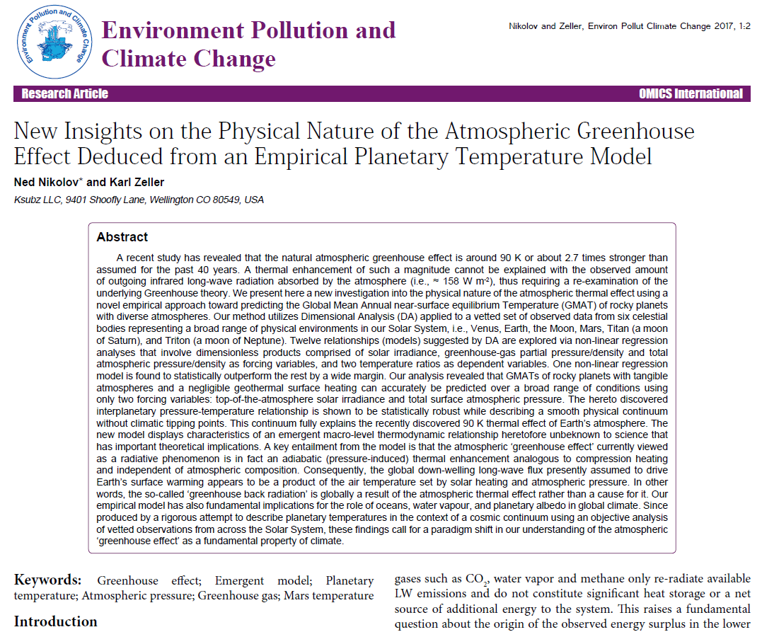
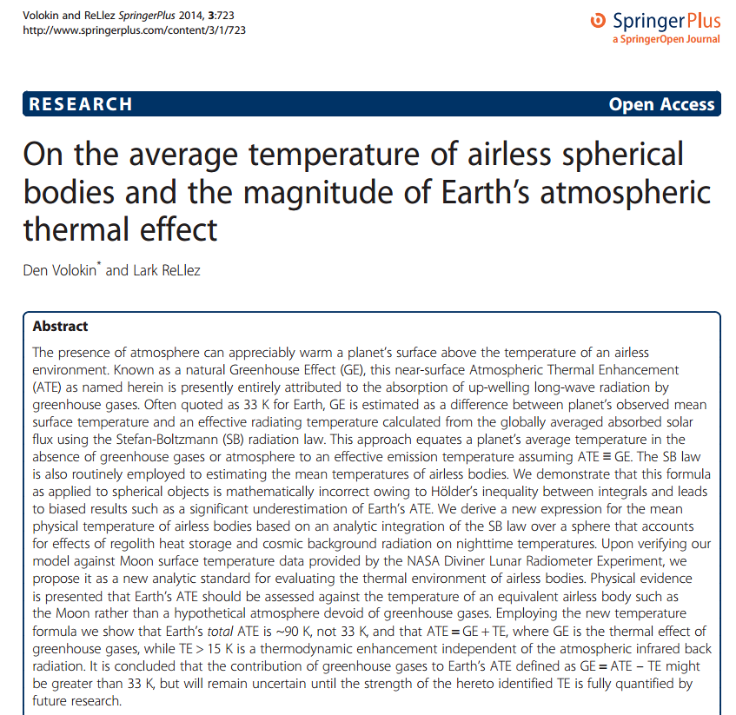

Slide 17
The NZ discovery,
Ts = f(S,Ps)
came from a limited # of extraterrestrial observations.
Is there any more evidence?

Slide 18
YES
Listen to Ned’s Talk Next

Slide 19


Slide 20


Slide 21
