Slide 1
BASIC SCIENCE OF A CHANGING CLIMATE Greenland: some simple observations on ice retreat and climate evolution

Slide 2
Medieval warming period

Slide 4
The greenland position: good conditions for a glaciation

Slide 5
The thickness of Ice: more than 3200m!

Slide 6
Greenland indlandis profile: its dissymetry

Slide 7
What if all the ice meltes?

Slide 8
Marine currents

Slide 9
Greenland position

Slide 10
Clima stations (nasa site)

Slide 11
ACCORDING TO NASA DATABASE
https://data.giss.nasa.gov/gistemp/station_data/

Slide 12
TEMPERATURE VARIATION IN GREENLAND: 1880-2017

Slide 13
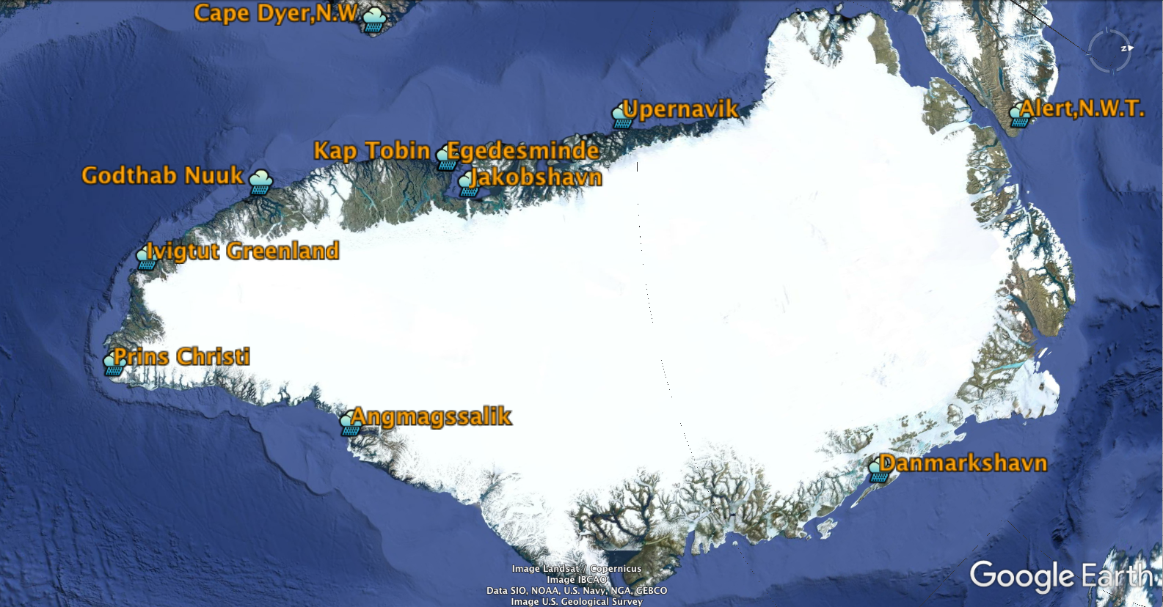
Greenland stations

Slide 14
Angmagssalik: Ups and downs in temperature

Slide 15
Stations to the West of Greenland

Slide 16
STATIONS TO THE EAST OF GREENLAND

Slide 17
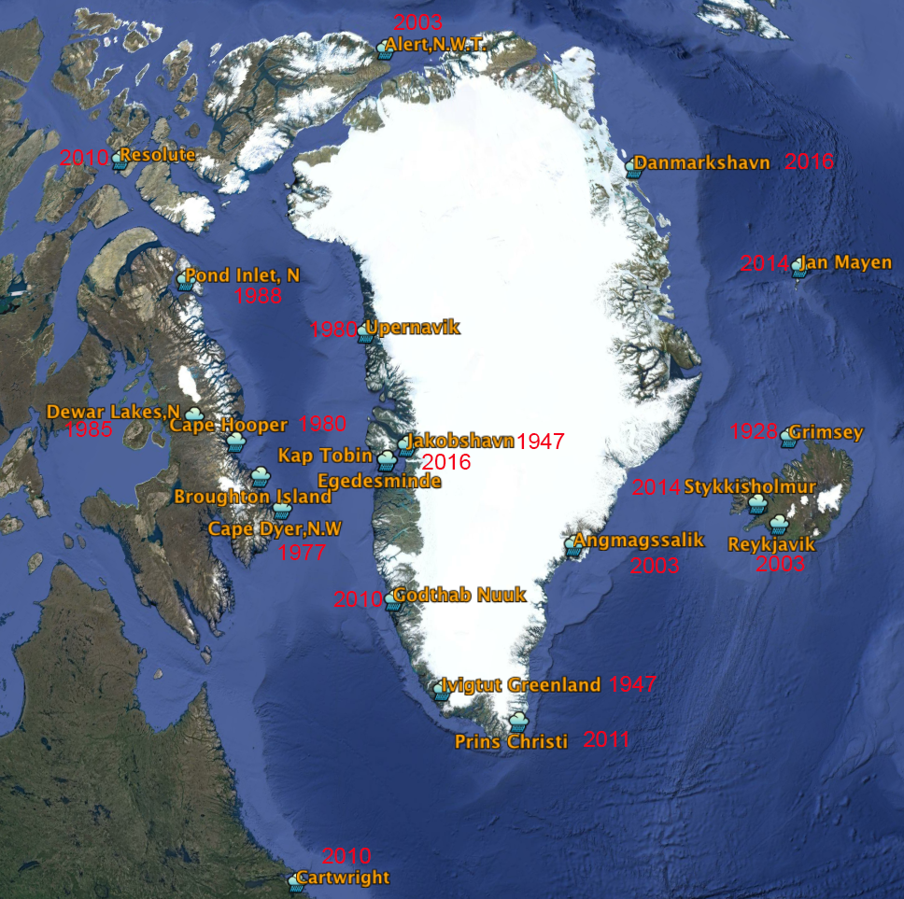
ß

Slide 18
Some conclusions
In some cases the series end before 1988 - These data are not representative
East: Reykyavi max temp: 2003
Extreem North & East max temp: 2016
To the West the most recente temperatures seem to be decreasing. Maximum: 2010
Southern Greenland: max temp: 2003 & 2016
There seems to be some warming near the poles. Why?
Jan mayen (North) max temp 2014
Western territories (Canada) max temp 2003
Some pattern: currents? Changes in jet stream?

Slide 19
The Canadian Coast Guard rescued two passengers of a sinking sailboat who were trapped on an ice floe in Arctic waters early Wednesday morning. The incident took place in Bellot Strait. (CBC) Drama in the northwest passage Sailing yacht gets into drift ice in the middle of the night, gets breached and sinks within minutes. The crew had to flee onto sea ice Pascal Schürmann on 29.08.2018

Slide 20
Some of the points marked in Southern GreeNland

Slide 21
Angmagssalik

Slide 22
1984

Slide 23
The biggest distance: 6900m retreat

Slide 24
Generally the retreat was much smaller

Slide 25
1 – 1984 was in the end of the coldest years
2 – 2016 was near the maximum temperatures
There is still a lot of Ice!
A new cold period will improve that

Slide 26
Thanks for your attention!

