Slide 1
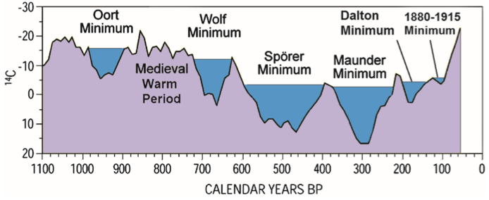
Cause of the Little Ice Age and Climate Change
by Don J Easterbrook
This great scientist is unfortunately unable to attend in person.
The paper will be presented as a submitted ppt-show
Author of numerous papers and books, in particular the two Elsevier books (2011 & 2016) on Evidence-Based Climate Change.

Slide 2
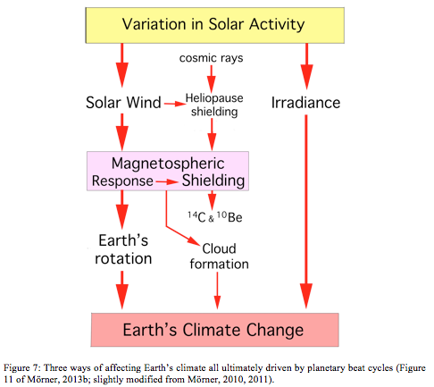

Slide 3
Cause of the Ice Little Age and Climate Changes
Dr. Don J. Easterbrook
Professor of Geology
Dept. of Geology
Western Washington University
Bellingham, WA

Slide 4
The remarkable correlation of Sun spot numbers, (SSN), total solar irradiance (TSI), solar magnetic flux, cosmic ray intensity, production rates of 14C and 10Be, ionization in the atmosphere, cloud production, and global temperature over thousands of years provide geologic evidence for a likely solar cause of climate change.
Years of debate over solar causes of climate change have remained controversial, and no consensus has been reached. However, the geological evidence presented here is unequivocal and provides a solid basis for interpretation of the cause of climate changes.
To distinguish the concepts presented here from earlier debates of solar influence, the phrase ‘Geologic Response to Changes in Solar Magnetism’ will be used in this paper.
Decreasing solar magnetic field intensity results in fewer sunspots (SSN) and lower total solar irradiance (TSI). Although SSN and TSI correlate well with global temperature, they are not the cause of climate changes--they are symptoms of solar magnetic intensity.
Fluctuations of the sun’s magnetic field causes changes in cosmic radiation received by the Earth (measured by production rates of 14C and 10Be), which induce condensation of water vapor to produce clouds that reflect solar energy, cooling the atmosphere.
14C and 10Be production rates were highest during cool periods and lowest during warm periods, which means that cosmic radiation was highest during cool periods and lowest during warm periods.
Times of low solar magnetic intensity were cool and times of high solar magnetic intensity were warm.

Slide 5
The Little Ice multiple cold periods from 1300 to 1980

Slide 6
‘Geologic Response to Changes in Solar Magnetism’

Slide 7
Factors
Number of sun spots (SSN)
Total solar irradiance (TSI)
Strength of the solar magnetic field
Cosmic radiation
Cloud cover
Global temperature

Slide 8
Possible influence of the sun
Number of sun spots (SSN)
Good correlation of SSN with global temperature.
Sun spots are a result of localized magnetic fields on the sun.
Sun spots are the effect of solar magnetic fields but are not the cause of climate change.
Changes in total solar irradiance (TSI).
TSI is solar energy per unit area at the Earth’s surface
Strong correlation between TSI and global temperature, not strong enough to affect global temperature.
Solar magnetic field
Controls the amount of cosmic radiation received by the Earth
Grand solar maxima and minimum affect global climate
Cosmic radiation
Varies with the strength of the solar magnetic field.

Slide 9
The role of sunspots

Slide 10
Sun spots (SSN)
Sunspots are dark depressions with temperatures of ~7,000° F.
Sunspots are regions of intense magnetic activity where temperature is lower due to reduction of heat
flow from the hotter interior by strong magnetic fields
The number of sun spots flucuates on an ~11 year cycle.
During times of low sun spot numbers, global climates are cool; during times of high SSN, global climates are warm.

Slide 12
The sun has just entered a Grand Solar Minimum,
which has been accompanied by deep global cooling in the past.
In 1650 and 1800 Grand Solar Minimums resulted in severe cooling known as the Little Ice Age
During Grand Solar Minima, sun spots become very rare

Slide 14
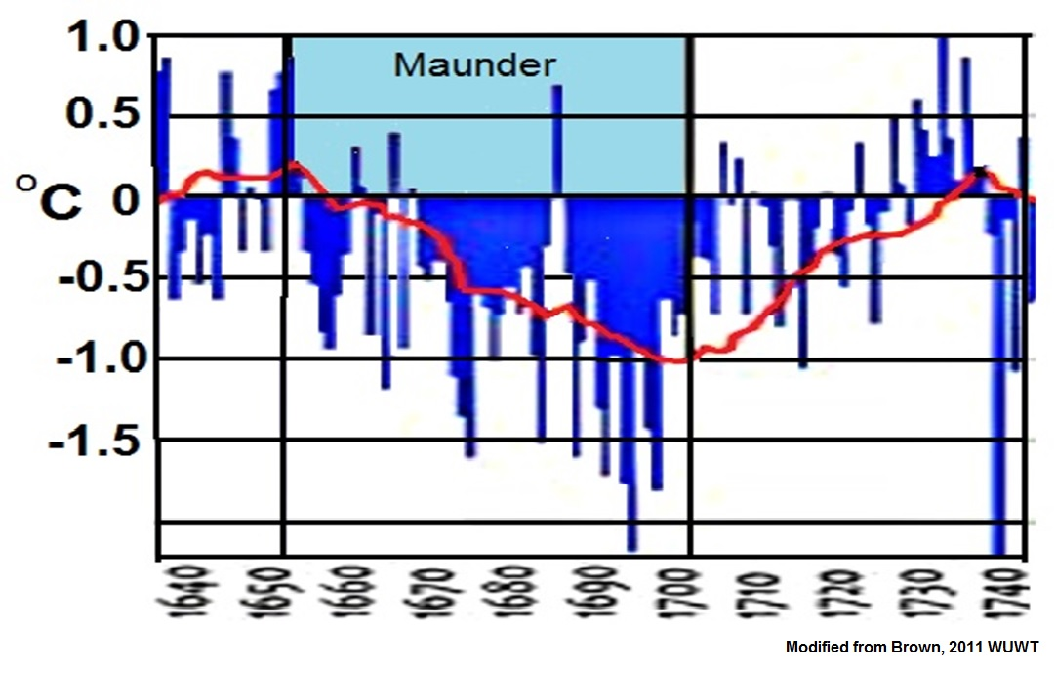
Temperature in England (CET) during the Maunder
Notes:
CET TEMPERATURES MIMIC THE SSN

Slide 15
Freezing of the Thames River, ‘frost festivals’ on the ice

Slide 16
Glaciers advanced during the Little Ice Age
Rhone glacier

Slide 17
When sun spots are low, temperatures are low
Notes:
TEMP CORRELATE DIRECTLY WITH SSN. TEMPERATURES LOW WHEN SSN IS LOW

Slide 18
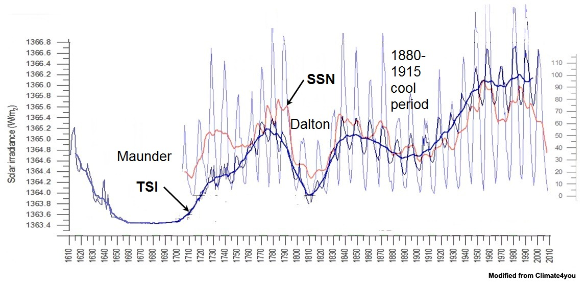
Solar Irradiance (TSI)
Solar irradiance is the electro-magnetic radiation per unit area received from the Sun in watts per square meter(W/m²). It correlates very well with sunspot number and global temperature.
electromagnetic radiation

Slide 19
WHEN SSN IS HIGH, TSI IS HIGH. WHEN SSN IS LOW, TSI IS LOW
Notes:
SSN AND TSI ARE IN STEP. BOTH LOW DURING COOL PERIODS

Slide 20
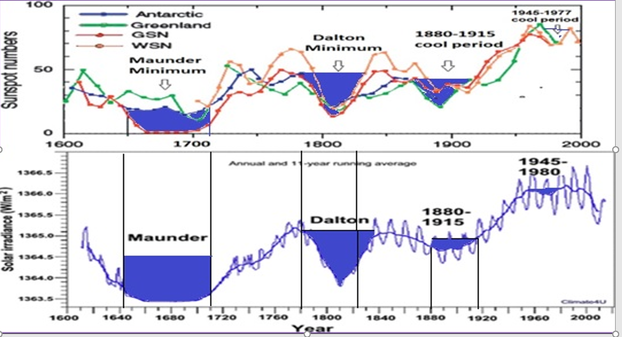
When sun spots are low, both TSI and temperature are low
Notes:
TEMPERATURES VARY WITH SSN AND TSI. WHEN SSN AND TSI ARE LOW, TEMPERATURE IS LOW

Slide 21
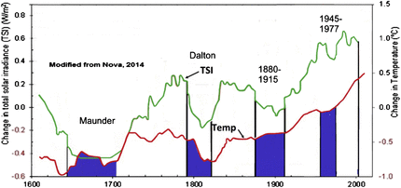
From 1600 TO 2000, whenever solar irradiance was low,
temperature was low
Notes:
WHEN TSI IS HIGH, TEMPERATURE IS HIGH, WHEN TSI IS LOW, TEMPERATURE IS LOW

Slide 22
From 1750-1990, when solar irradiance was low, temperaturewas low
Notes:
TEMPERATURE FOLLOWS TSI ALMOST EXACTLY. WHEN TSI IS HIGH, TEMPERATURE IS HIGH, WHEN IT IS LOW, TEMPERATURE IS LOW.

Slide 23
From 1480 to 2000, whenever irradiance was low, temperatures were low
Notes:
CORRESPONDENCE OF SOLAR IRRADIANCE AND CLIMATE CHANGE OVER THE PAST 500 YEARS. COOL PERIODS CORRESPOND TO LOWER SOLAR IRRADIANCE.

Slide 24
SSN and TSI are not the cause of global temperature changes.
Despite excellent correlation of TSI with global temperature, the range of fluctuation of TSI is too low to be the cause of temperature changes.
Thus, although both SSN and TSI correlate well with global temperature, neither is the cause of temp change. Rather, they are the result of solar changes.

Slide 25
The sun’s magnetic field shields the Earth from cosmic radiation.
When the sun’s magnetic field is weak, more cosmic rays strike the Earth.
When the sun’s magnetic field is strong, fewer cosmic rays strike the Earth

Slide 26
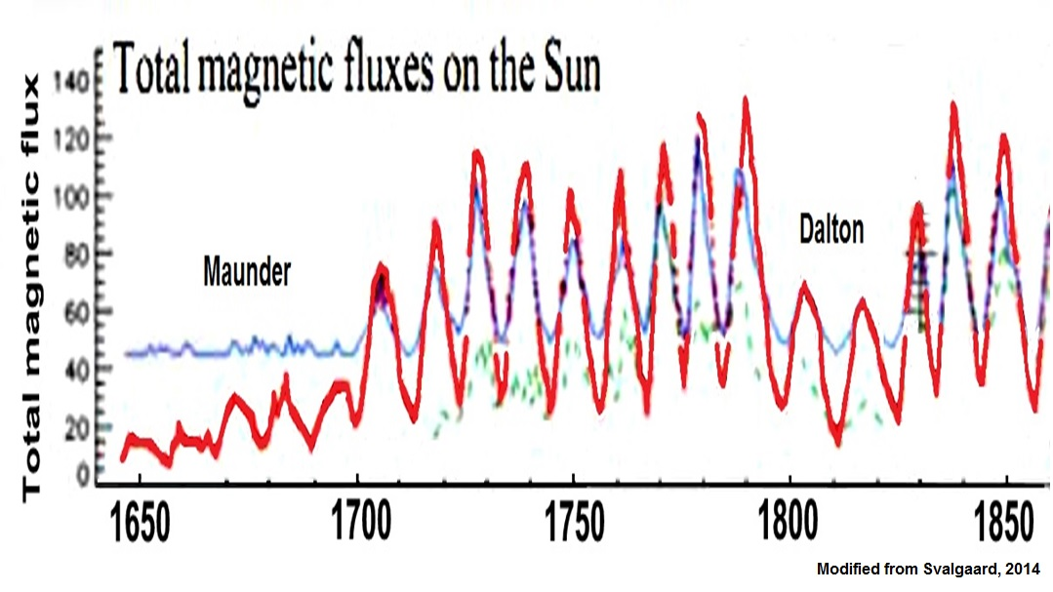
From 1645 to 1850, whenever solar magnetic flux
was low, temperatres were low
Notes:
WHEN SOLAR MAGNETIC FLUX IS LOW, TEMPERATURE IS LOW, WHEN IT IS HIGH TEMPERATURE IS LOW

Slide 27
When cosmic rays are high, cloud cover is high
Notes:
WHEN COSMIC RADIATION IS HIGH, LOW CLOUD COVER IS HIGH, WHEN IT IS LOW, CLOUD COVER IS LOW

Slide 28
When cosmic ray intensity is high, cloud cover
is high, and temperature is low
Notes:
AS COSMIC RAYS INCREASE, GLOBAL TEMPERATURE INCREASES.

Slide 29
How can cosmic ray intensity in the past be measured?
14C and 10Be produced in the upper atmosphere by cosmic rays
can be used to measure ancient cosmic rays intensity
Notes:
HOW CAN WE MEASURE COSMIC RAYS IN THE PAST?

Slide 30
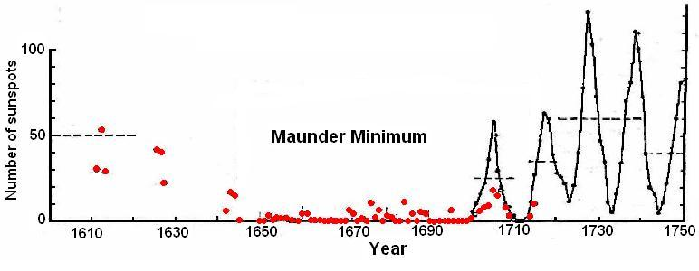
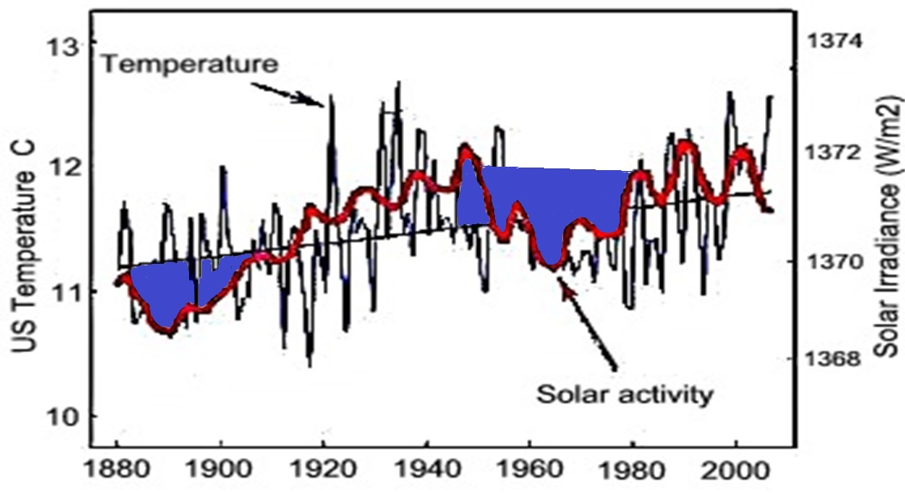
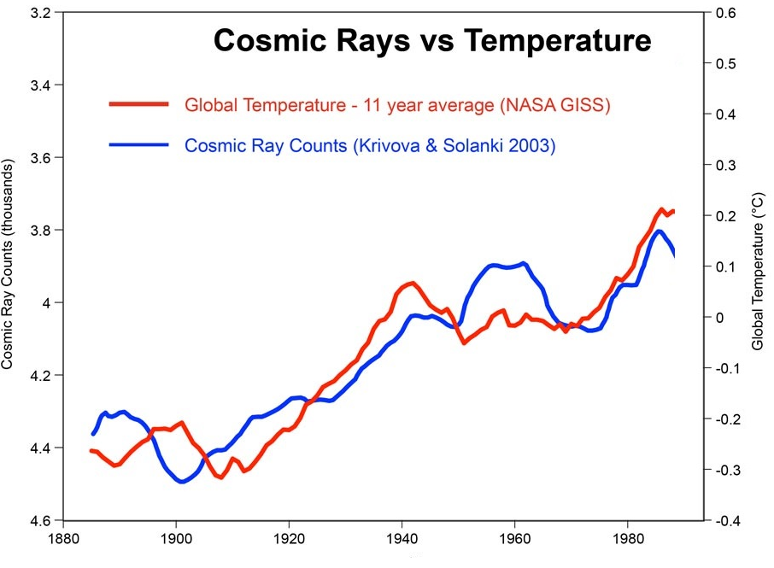
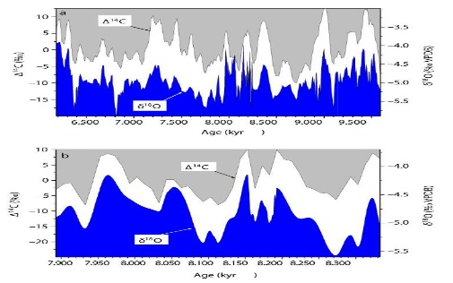
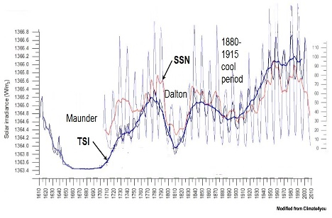
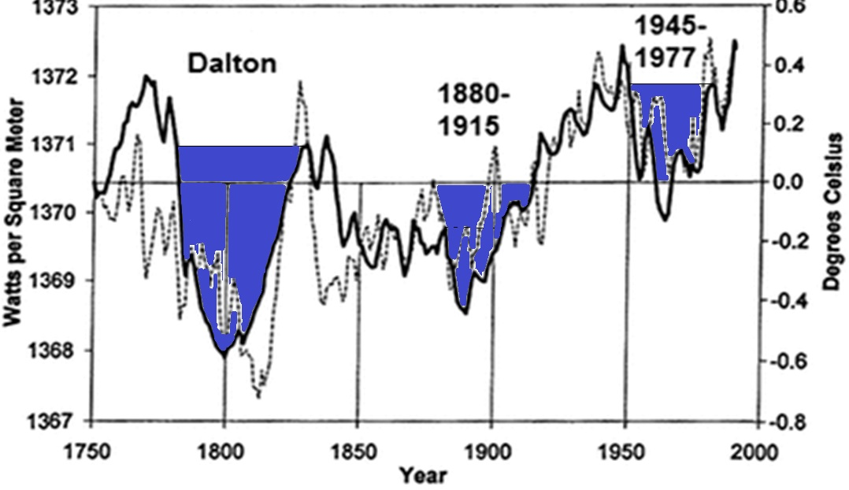
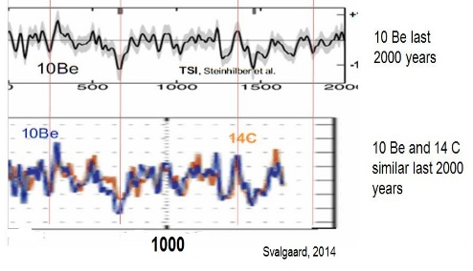
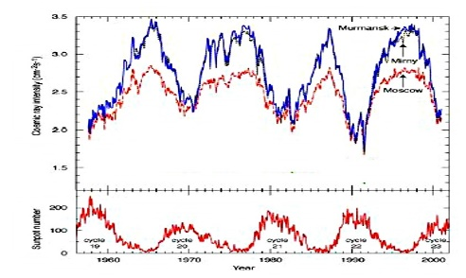
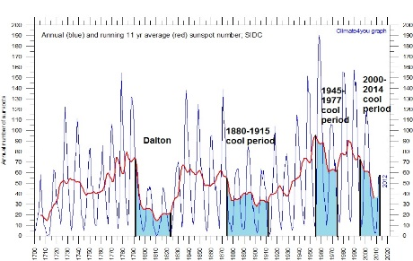
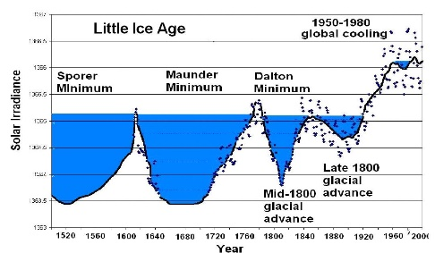
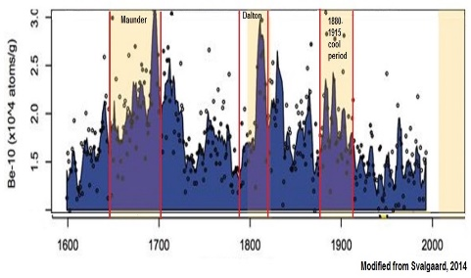
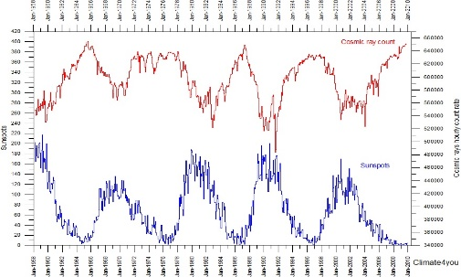
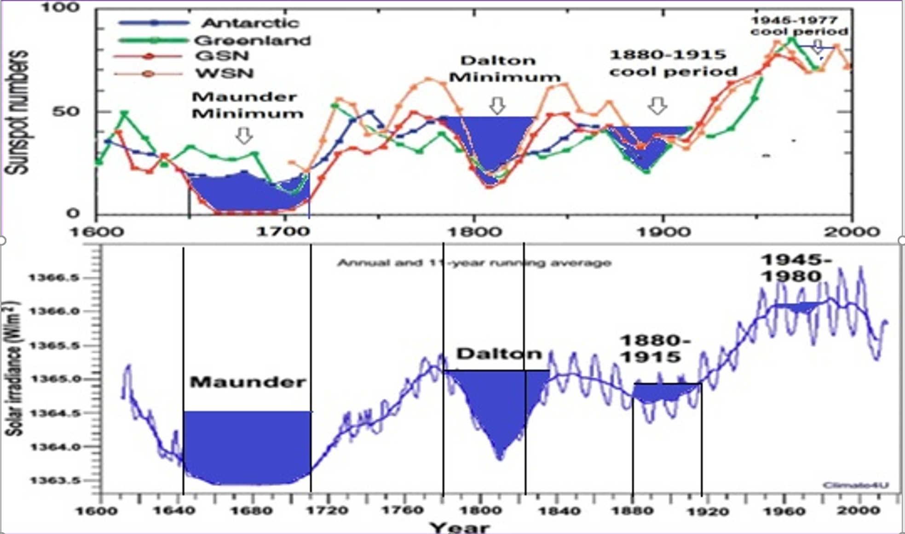
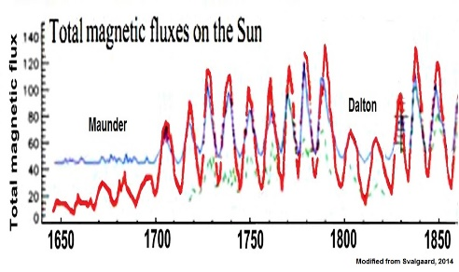
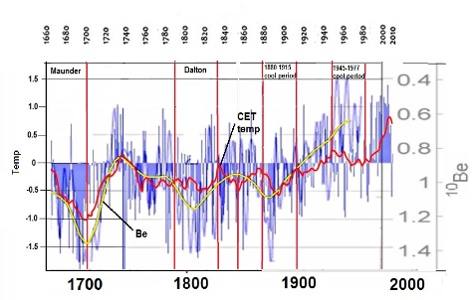
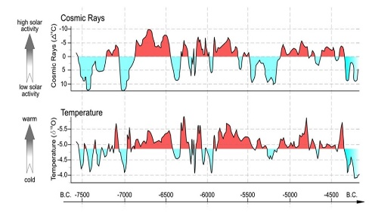
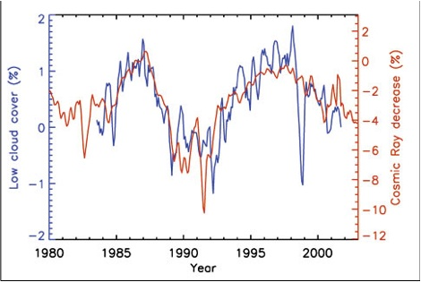
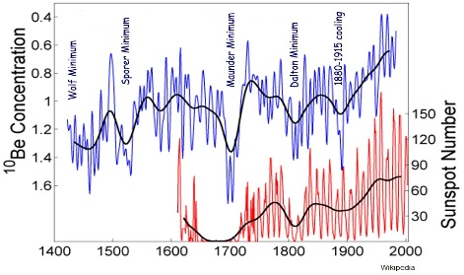
CONCLUSION
Correlation of temperature, sun spots, solar irradiance, solar magnetism, cosmic ray intensity, 14C and 10Be, Grand Solar Maxima and Minima, cloudiness, and total solar flux cannot be just coincidental.
They must be related to cause-and-effect solar relationships
Notes:
oud

Slide 31
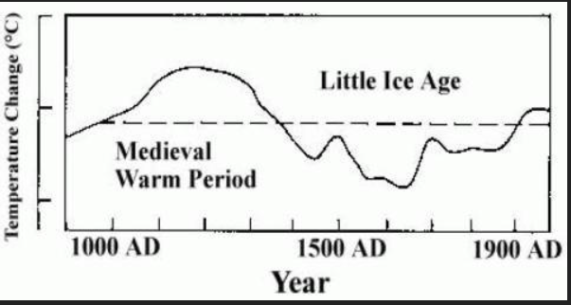
During the Medieval Warm Period (900-1300 AD) crops flourished and many great cathedrals were built. In the year 1300, the climate suddenly turned bitter cold and the Little Ice Age began. Crops failed repeatedly, bringing great famines. Roughly half of the population Europe died of starvation and disease

Slide 32
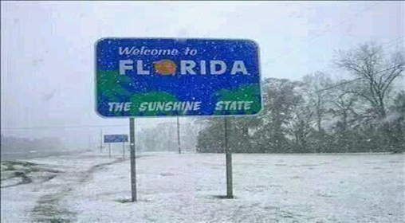
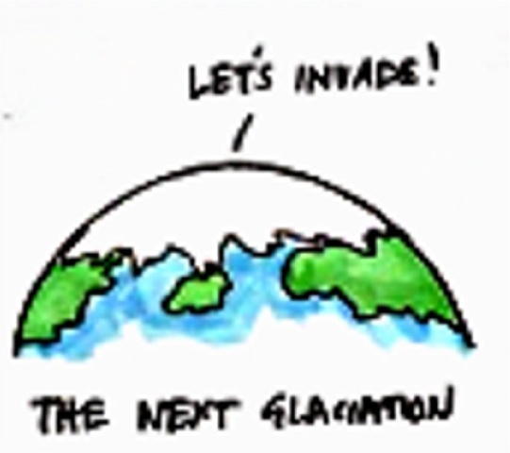
GLOBAL COOLING IS A FAR GREATER
THREAT THAN GLOBAL WARMING

Slide 33
Text added by the presenter
The END
with all the credit to Don,
this Great Scientist
with so much on his lyre

