Slide 1
Complexity, Causality and Dynamics inside the Climate System
Henri A. MASSON
Prof. Dr. Ir. (emer.) Univ Antwerp (Belgium)
Paper presented at the « Basic Science of a Changing Climate » Conference
Porto (Portugal) 07-08 September 2018

Slide 2
Object
Creative & Critical Thinking on IPCC models
Some suggestions (open to discussion)
  Pitfalls to avoid (leading to fake conclusions)
  New approaches in Climate Science
    Research methods
      Complex system analysis
      (Non Linear) Data analysis
    Chemical process engineering dynamics (& Applied Thermodynamics)

Slide 3

IPCC Models are wrong
(as we know all…)

Slide 4
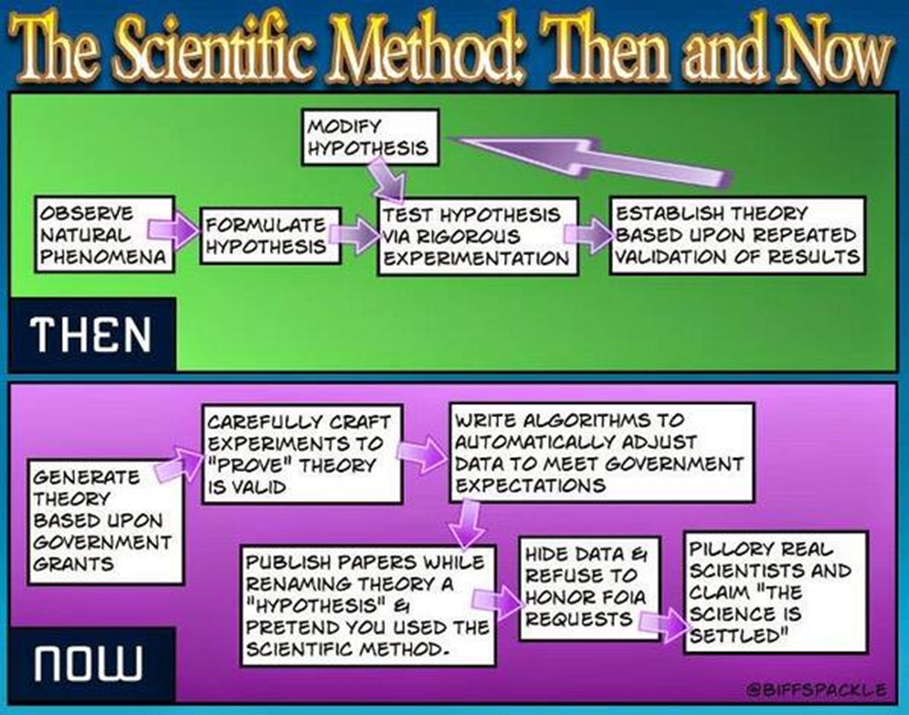
A Post-modern Approach

Slide 5
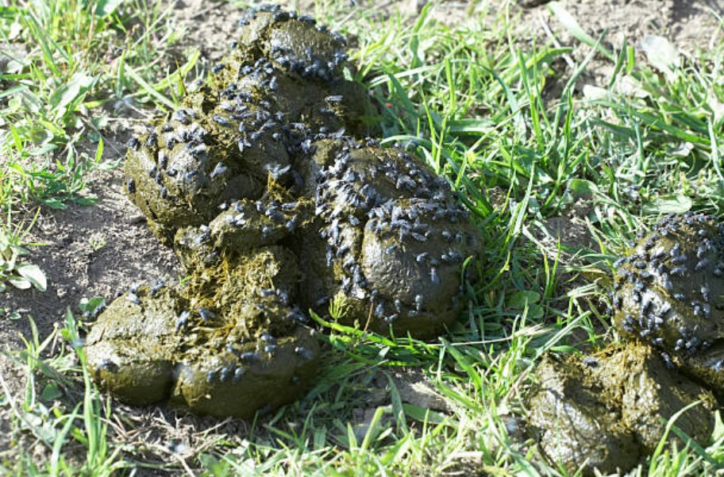
A Post-modern Approach
But there is 97% (?) consensus among [autoproclamed] experts (?)….
Sorry, consensus is not a scientific research method
NB: FOIA: Freedom Of information Act (USA)
FLIES have CONSENSUS

Slide 6
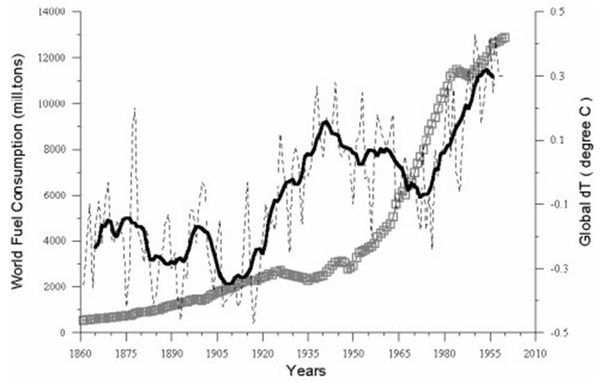
A problem of time window
Temperature Anomalies & fossil fuels consumption
« Time window » considered by IPCC
A side effect of phasing out CFCs and acid rain gases ?
Conclusion (fallacieuse): les anomalies de température globale suivent assez
sensiblement la consommation de combustibles fossiles => ceux-ci sont coupables !!!!

Slide 7
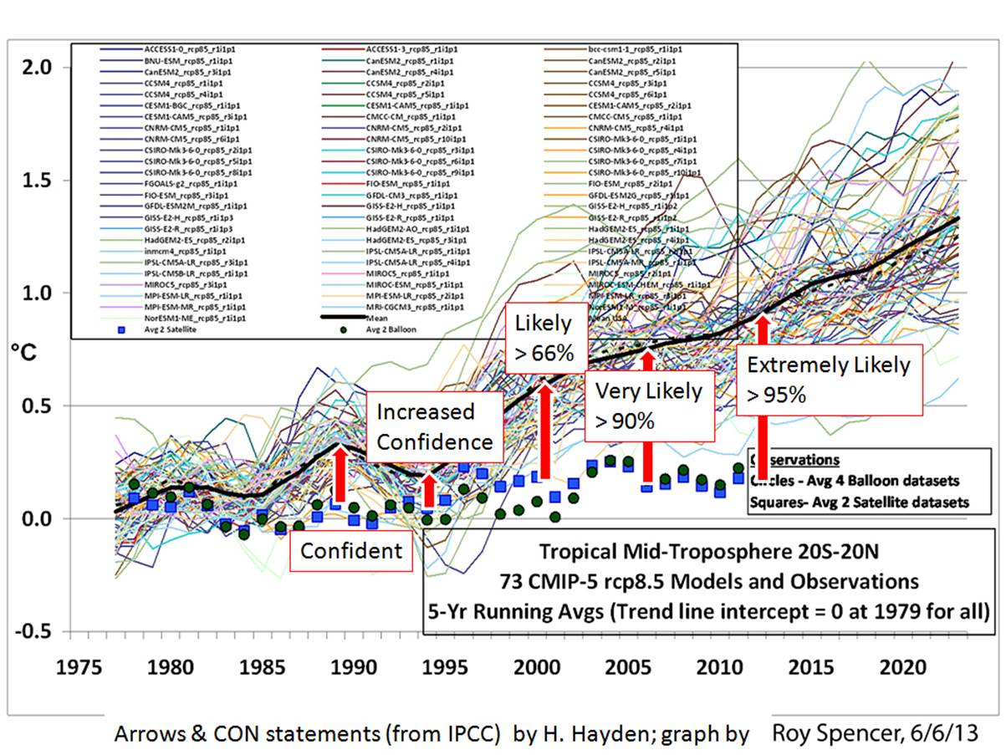
Models, Experimental Results & Level of Confidence
Source: http://www.energyadvocate.com/fw95.htm

Slide 8
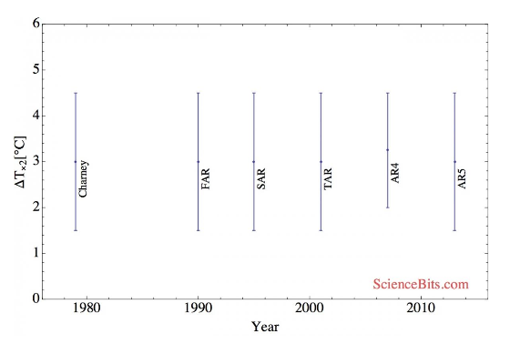
The Dispersion of IPCC Models versus Time
No improvement after 30 years of intensive use of costly hyper-computers…

Slide 9


Slide 10
What went wrong?

Slide 11
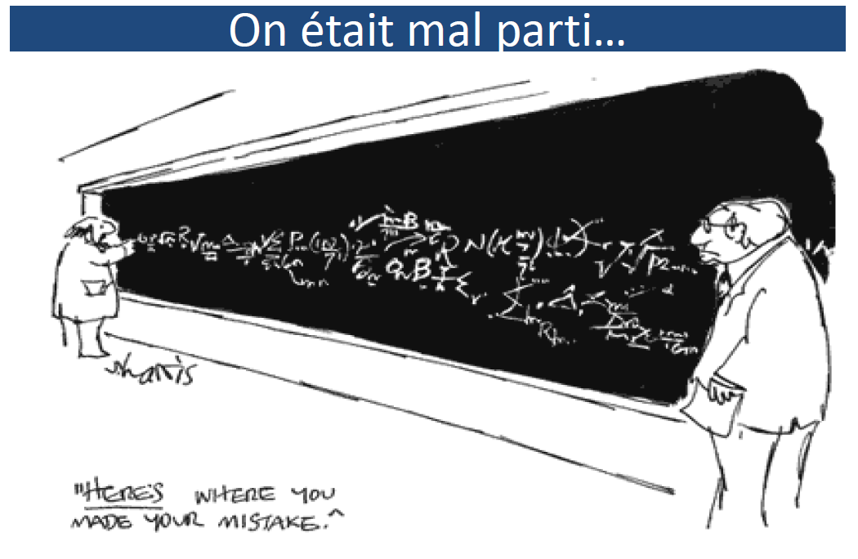
Well….
IPCC choose a VERY Bad Starting Point…

Slide 12
What went wrong?
Forcings
Understanding the structure of a (complex) system before tackling its dynamics
Local equilibrium + Navier-Stokes equations
Temperature anomalies (& cyclic data)
Projections & Non-Linear (cyclic and chaotic) time series
Correlation does not mean Causality

Slide 13
1- Forcings
Forcings & their imprecision
Hidden hypotheses
Zoom on N-L equations with delay (logisitc equation)

Slide 14
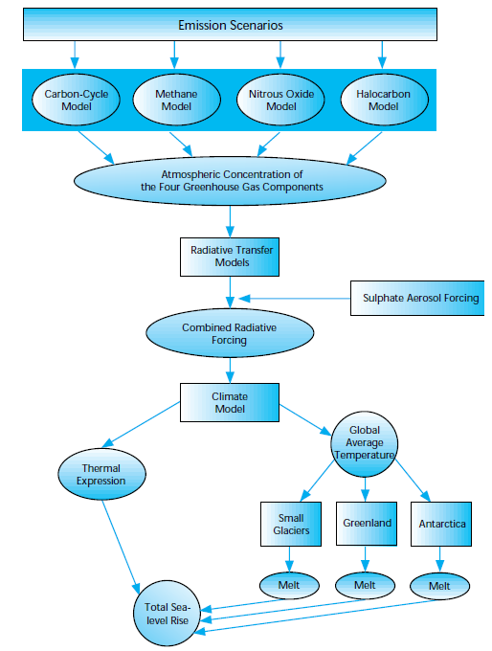
IPCC Approach
Focus on radiative forcing + corrections

Slide 15
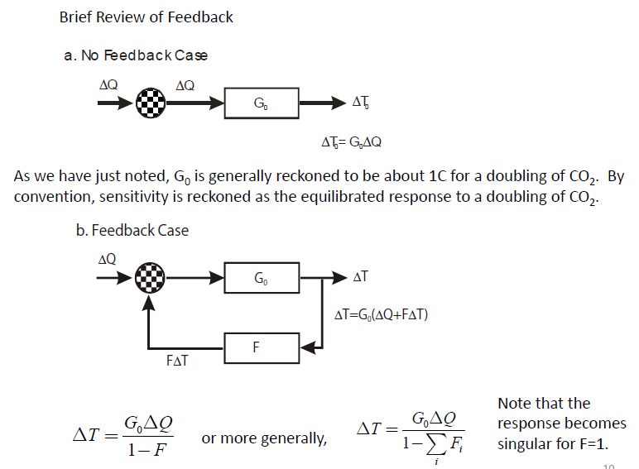
The Logic behind Forcings

Slide 16
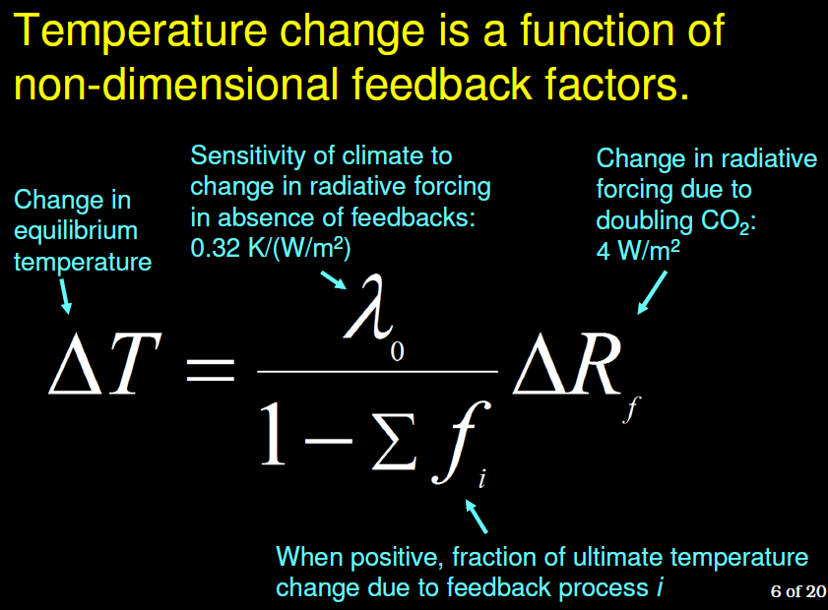
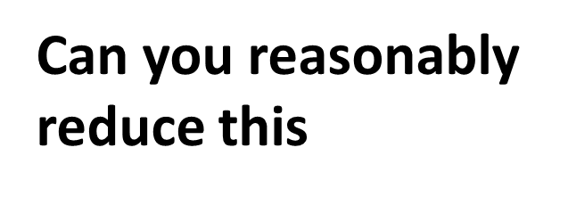
The Core Formula….

Slide 17
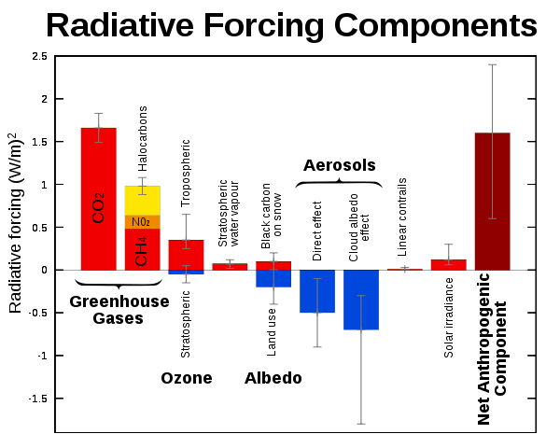
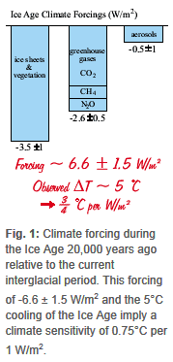

Relative Weight of Forcings
Climate sensitivity
[tycally 0.75 -0.8 °K/(W/m²]
ΔF : Relative Radiative Forcing résulting from doubling the concentration in atmospheric CO2
(tycally 4-8 W/m²)
For CO2, approximatively:
Vapeur d’eau non considérée (mais principal gaz à effet de serre !!!)
Nuages non considérés (mais rôle prépondérant)
Effet purement additif et linéaire des forcings pris en compte????
Quid si interactions entre « forcings » ???

Slide 18
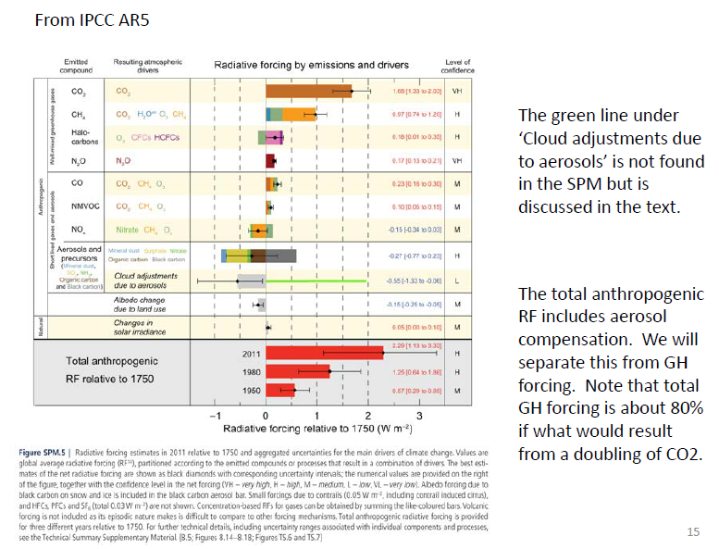

Slide 19
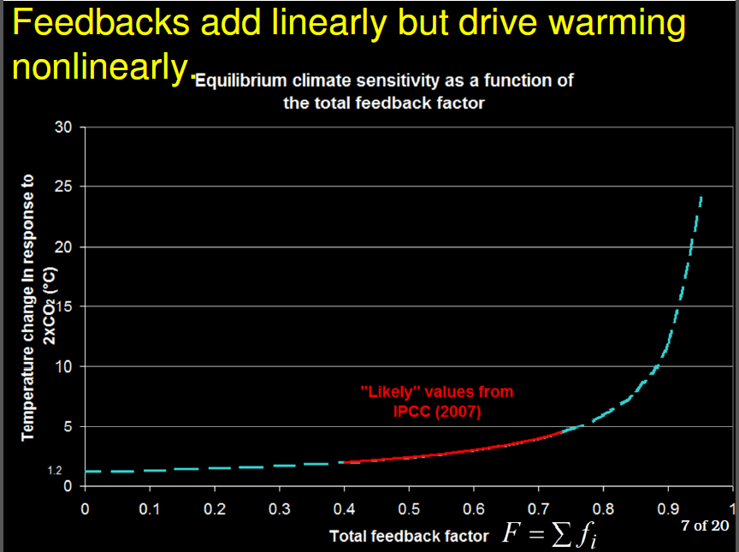
« possible » cumulated feedback (IPCC)
0.4< Σf_{i} <0.75
Resulting Temperature Increase after doubling CO2 concentration in the atmosphere
without feedback: 1.2°C
75% feedback: 5°C
Non linear effect on temperature:
=> The order followed for introducing « feedbacks » change their relative « weight »

Slide 20
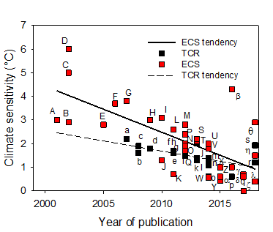
Sensitivities
(ΔT resulting from doubling CO2 concentration in atmosphere)
Update of compilation of TCR and ECS climate sensitivity versus year of publication, together with a linear regression of each set of results. A: Andronova & Schlesinger 2001, B: Forest et al 2002, C: Knutti et al 2002, D: Gregory et al 2002, E: Frame et al 2005, F: Forest et al 2006, G: Tomassini et al 2007, H: Allen et al 2009, I: Lin et al 2010, J: Spencer & Braswell 2010, K: Lindzen & Choi 2011, L,e: Libardoni & Forest 2011, M: Olsen et al 2012, N,i: Schwartz 2012, O,g: Aldrin et al 2012, P: Ring et al 2012, Q,h: Rojelj et al 2012, R: Aspen 2012, S,k: Otto et al 2013, T,l: Lewis 2013, U: Skeie et al 2014, V: Lewis & Curry 2014, W: Ollila 2014, X,p: Loehle 2015, Y: Soon et al 2015, Z: Monckton et al 2015, α: Kissin 2015, β: Tan et al 2016, γ: Bates 2016, δ: Abbott & Marohasy 2017, ε: Harde 2017, ζ: Holmes 2017, η: Lewis & Curry 2018, θ: Dessler et al 2018, λ: Smirnov 2018, a: Stott & Forest 2007, b: Knutti & Tomassini 2008, c: Gregory & Foster 2008, d: Meinshausen et al 2009, f: Padilla et al 2011, g: Gillett et al 2012, j: Harris et al 2013, m: Skeie et al 2014, n: Lewis & Curry 2014, o: Harde 2014, p: Gervais 2016, q: Ollila 2017, r: Lewis & Curry 2018, s: Smooth 2018.
Source: François Gervais, Porto Conference September 2018)
ECS: Equilibrium climate sensitivity
TCR: Transient climate response
(averaged over 20 years)
See also: https://en.wikipedia.org/wiki/Climate_sensitivity

Slide 21
The FORCING Paradigm is based on hidden hypotheses
FORCINGS are
Linear (proportionnal to température)
Indépendant from each others (additive)
Instantaneous
  Otherwise: time delayed equation
  Non linear
Constant over time
  Cloud coverage?
!!!! Nature exhibits many time constants, for example:
  Ocean basin volume divided by “streams” flowing through it
  Germination & growth of plants & plancton,
  (Seasonal) melting time of a glacier (and local change in albedo)
  Etc.

Slide 22
Is this so important? case: the logistic equation

Slide 23
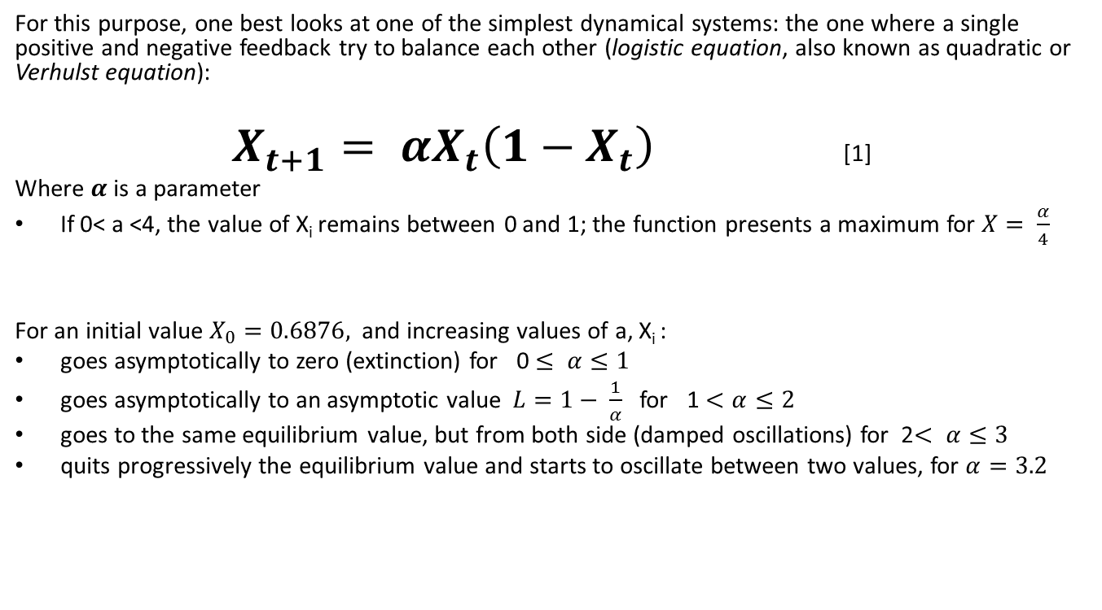
A Simple Chaotic Function:
The Logistic (Quadratic) Equation
For this purpose, one best looks at one of the simplest dynamical systems: the one where a single positive and negative feedback try to balance each other (logistic equation, also known as quadratic or Verhulst equation):
$X_{t+1}= {αX}_{t}\left(1−X_{t}\right)$ [1]
Where $α$ is a parameter
If 0< a <4, the value of X_{i} remains between 0 and 1; the function presents a maximum for $X= \frac{α}{4}$
For an initial value $X_{0}=0.6876,$ and increasing values of a, X_{i} :
goes asymptotically to zero (extinction) for 0 $≤ α≤1$
goes asymptotically to an asymptotic value $L=1− \frac{1}{α}$ for 1 $<α≤2$
goes to the same equilibrium value, but from both side (damped oscillations) for 2$< α≤3$
quits progressively the equilibrium value and starts to oscillate between two values, for $α=3.2$

Slide 24
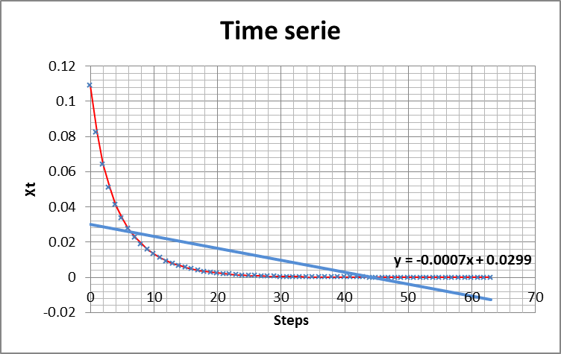
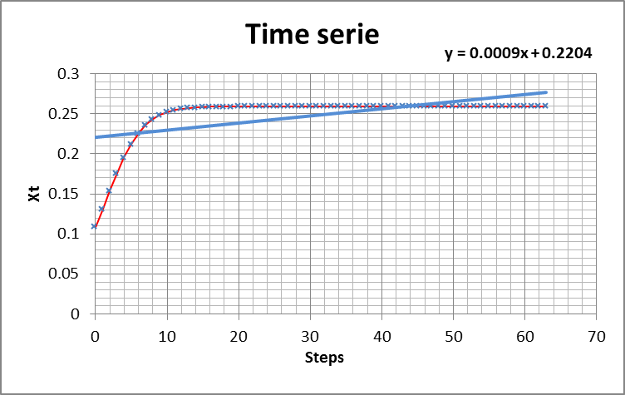
Logistic Equation:
Assymptotic Behaviour
X₀ = 0.109
α =0.85
X₀ = 0.109
α =1.35

Slide 25
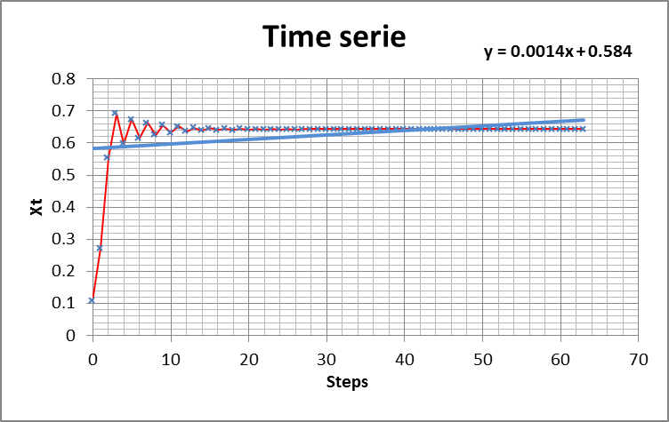
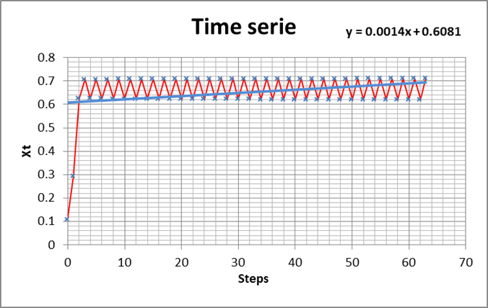
Logistic Equation:
Oscillating (Assymptotic) Behaviour
X₀ = 0.109
α =2.8
X₀ = 0.109
α =3.01886

Slide 26
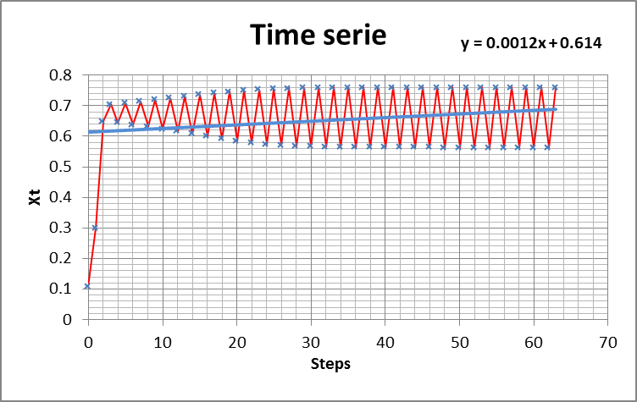
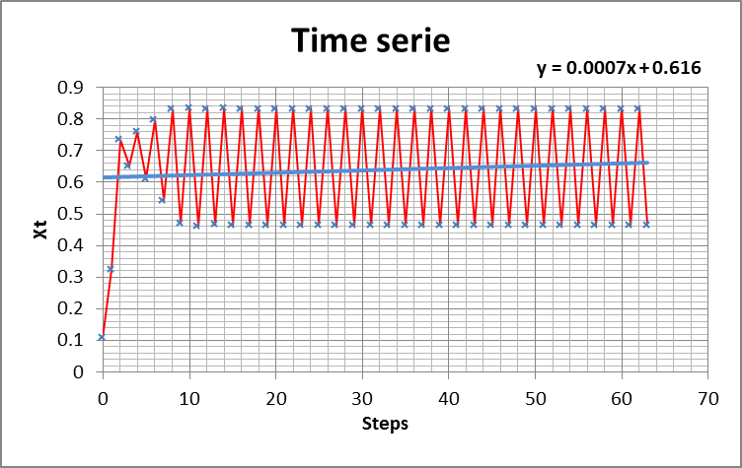
Logistic Equation:
Periodic Behaviour
X₀ = 0.109
α =3.09
X₀ = 0.109
α =3.35

Slide 27
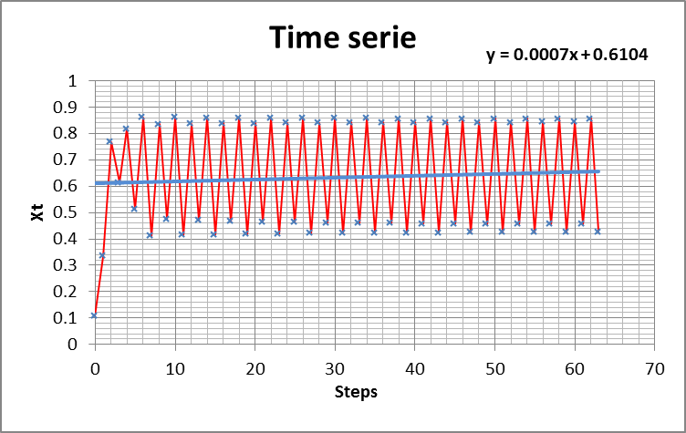
Example of a slightly Chaotic Signal
Example of time series for a chaotic signal (logistic (or quadratic) equation
(X₀ = 0.6, α =3.45)
The amplitude of the signal clearly oscillates between 4 attractors

Slide 28
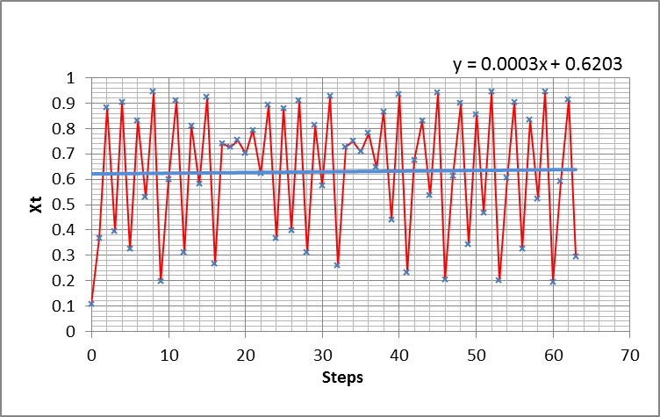
Example of a more chaotic signal
Logistic equation (X₀ =0.109; a = 3.79304) showing a slight positive trend versus time and “intermittent quite zones”.
Logistic equation (X₀ = 0.109; a = 3.79354) showing almost no trend versus time
Parameter value changed by 5*10⁻⁴ between the two curves
Signifiance of a trend line
with chaotic signals???

Slide 29
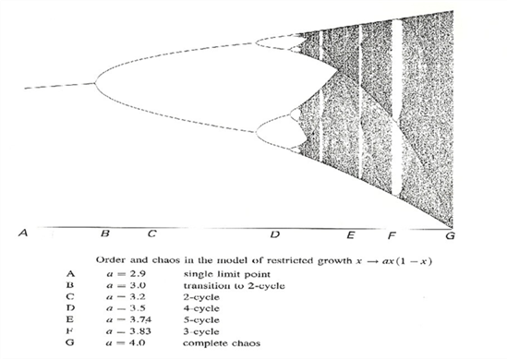

Sensitivity on Parameter $α$
Bifurcations
Bifurcations
Bifurcations
Bifurcations
Bifurcations
Apparition of (sub-)harmonics at bifurcation points is a common way to a chaotic state

Slide 30
Is this relevant to climate ?

Slide 31
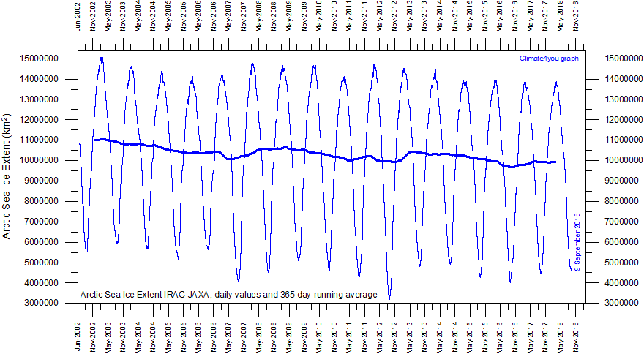
Sea Ice Extend
Significance of the trend line?
Signal is still quasi periodic but Extrema are fluctuating like in a slightly chaotic system
Source: http://www.climate4you.com/images/IRAC%20JAXA%20ArcticSeaIceExtentSince20020601.gif

Slide 32
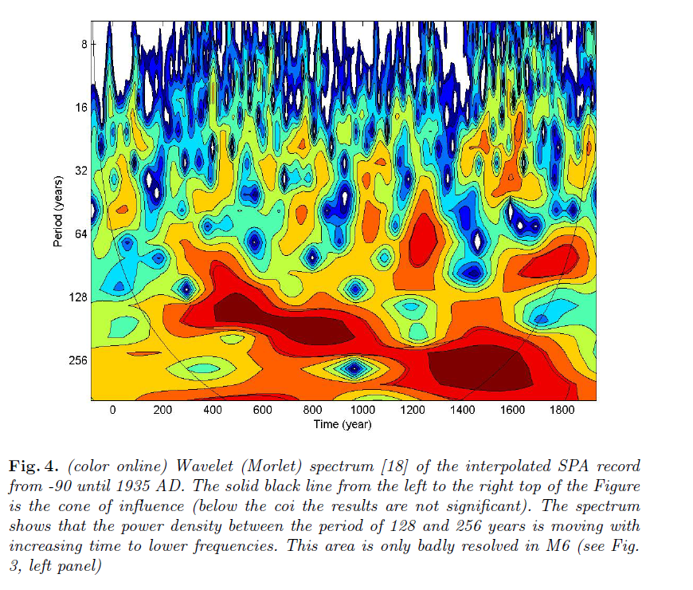
H-J. Ludecke, A. Hempelmann, and C. O. Weiss (2012)

Slide 33
Do strong cyclic signals (in resonance?) split in (sub-)harmonics ?
Bifurcations
Bifurcations
Bifurcations
Bifurcations
Bifurcations
Bifurcations
H-J. Ludecke, A. Hempelmann, and C. O. Weiss (2012)

Slide 34
2- Understanding the STRUCTURE of the climate system before tackling its dynamics

Slide 35
2.1 the ocean

Slide 36
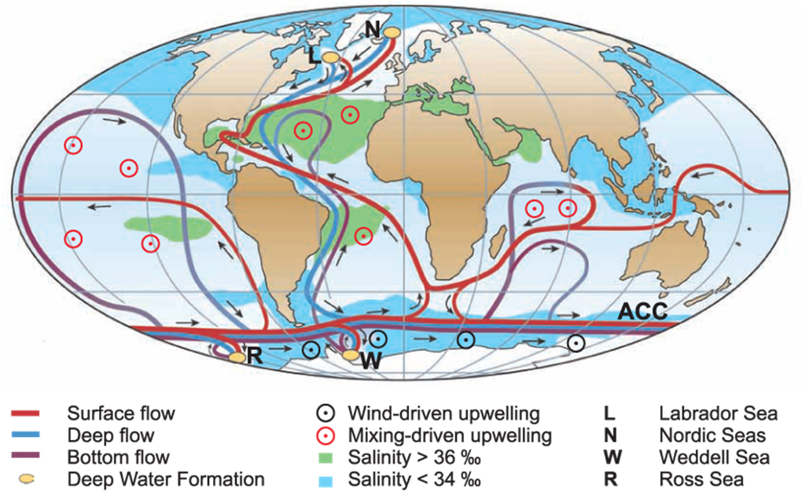

Slide 37
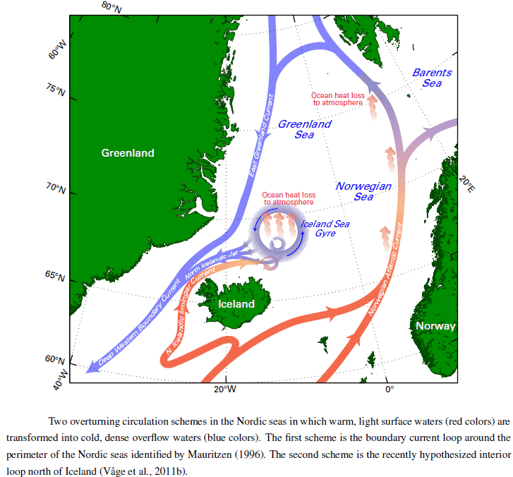

Slide 38
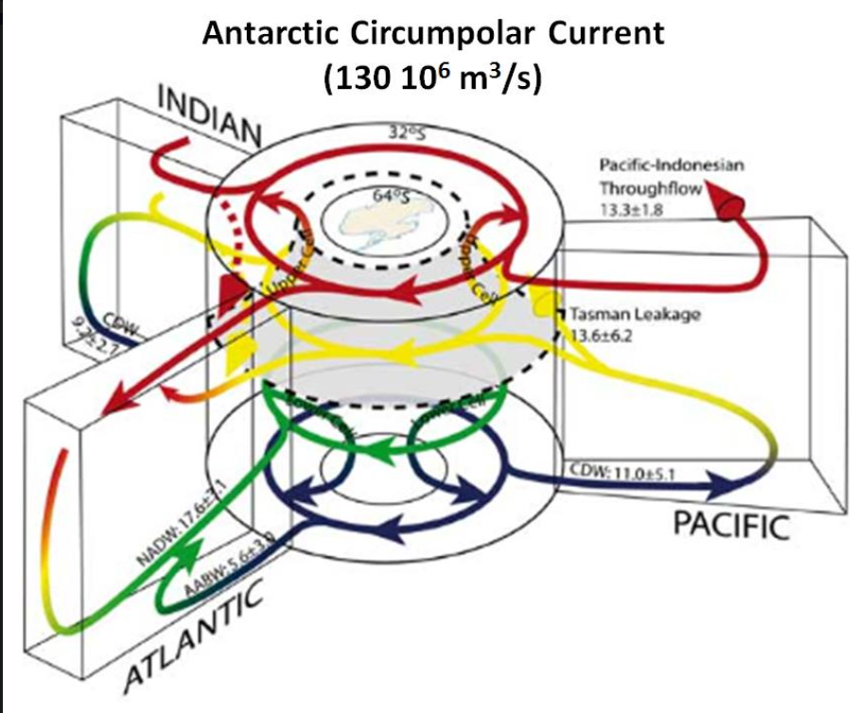
Quantified flows…

Slide 39
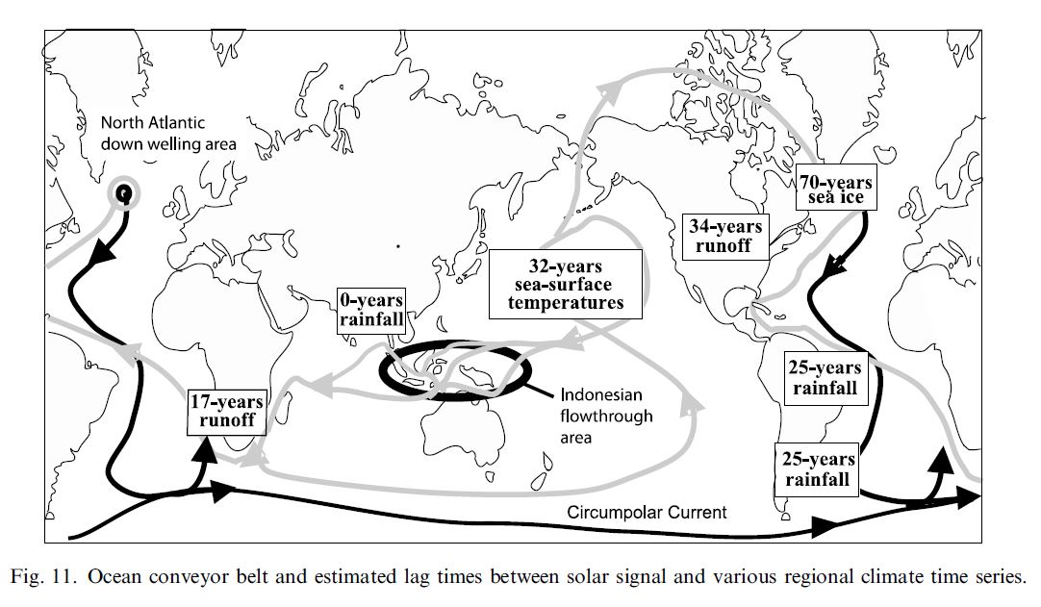
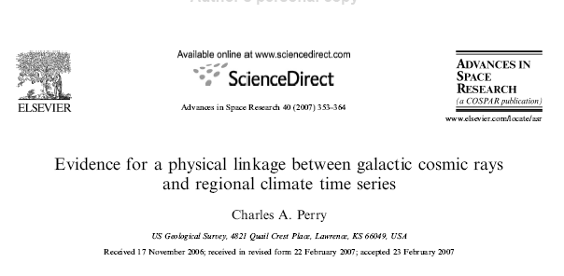

Slide 40
2.2 the ocean – atmosphere coupling

Slide 41
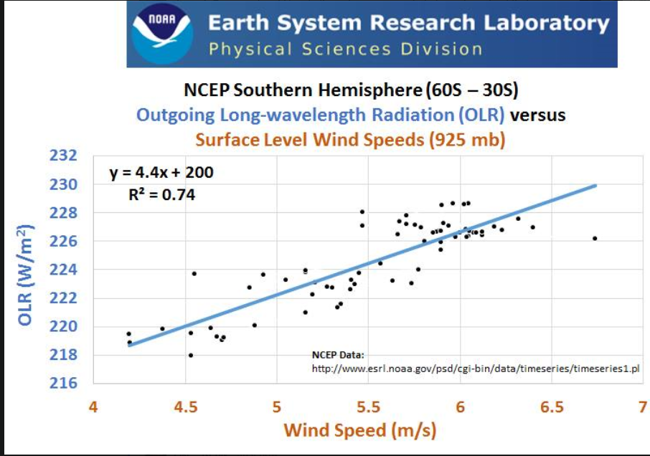
Ocean-Atmosphere Coupling
(Westerlies)

Slide 42
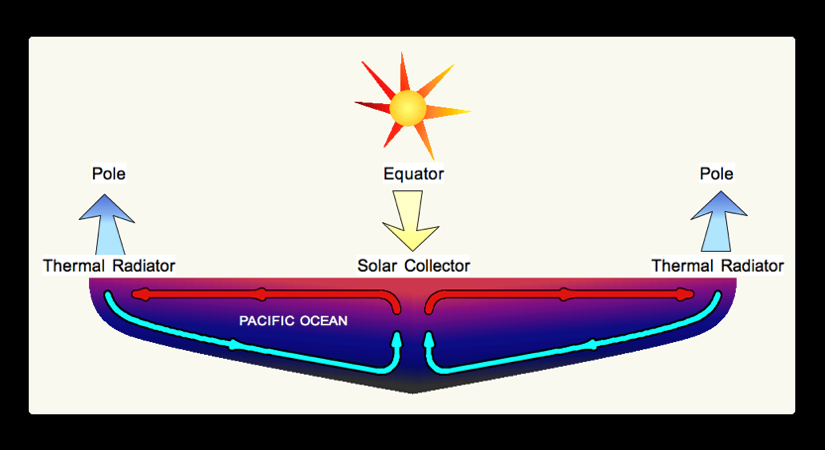
Atmosphere-Ocean
H&M Transfer Mechanism

Slide 43
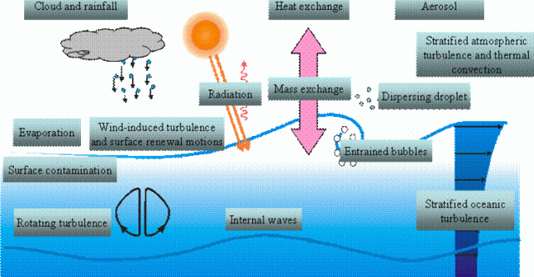
Some more Complex Reality
A complex system with inter phase heat & mass transfer
and time delayed feedback loops

Slide 44
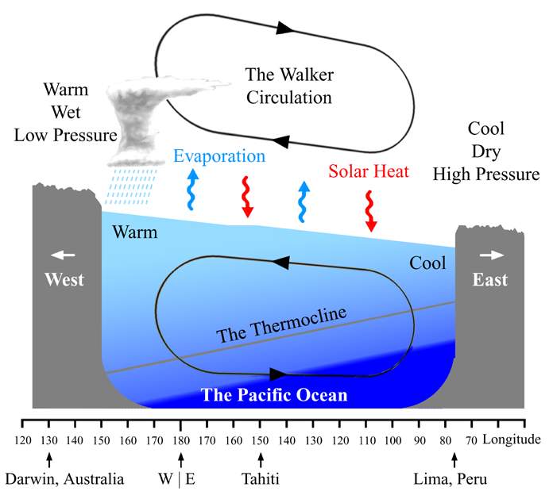
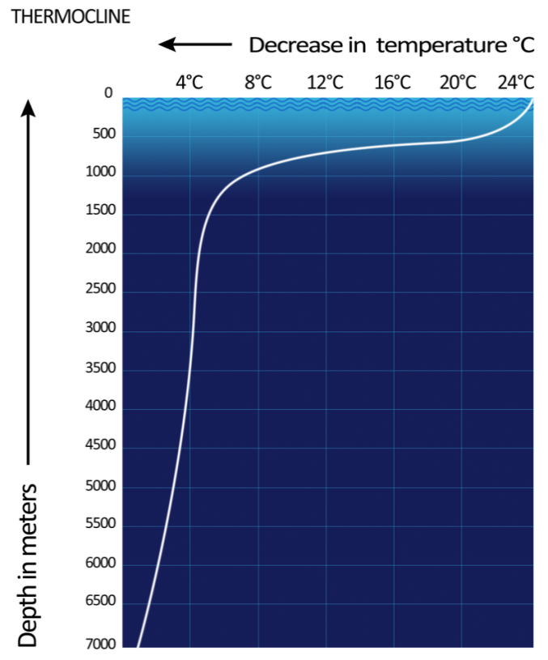
Walker Circulation

Slide 45
2.3 the atmosphere

Slide 46
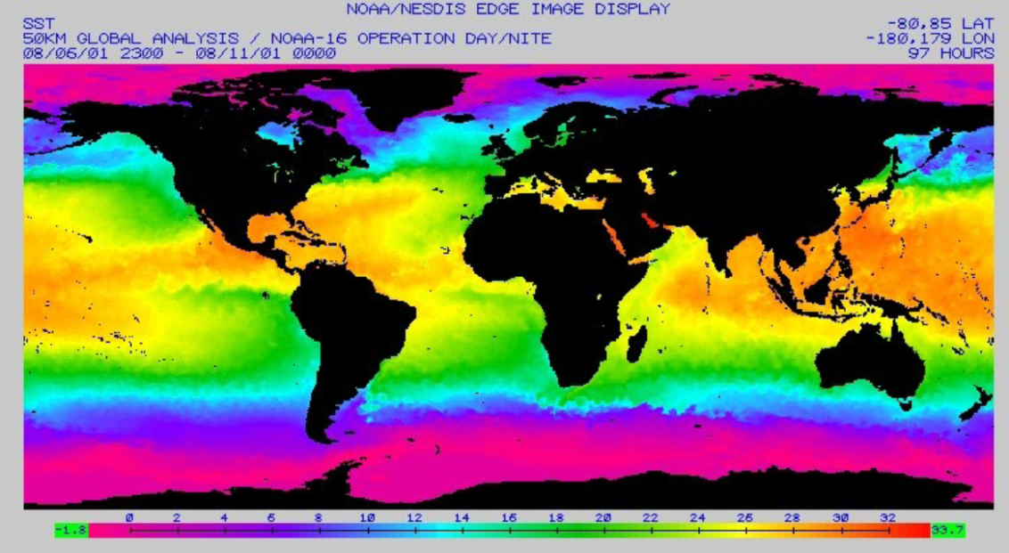
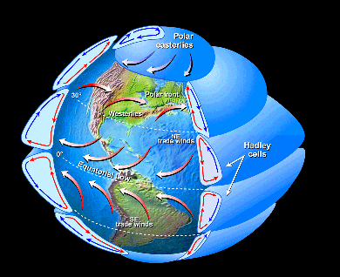
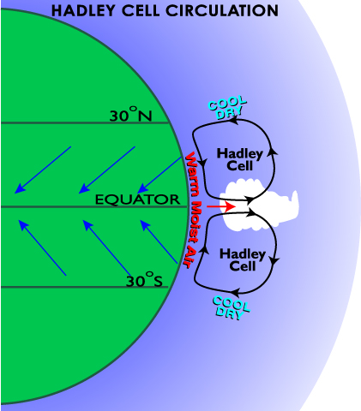
Hadley Cells
Surface Temperatures(source: NASA)
Convectif coupling between ocean-atmosphere
Origin of Trade Winds (& jet stream)
+ convective heat transfer
+ transfert matière convective mass transfer (H20 vapor & CO2)
Couplage Océan atmosphère Inclus (partly) included in IPCC GCM models

Slide 47
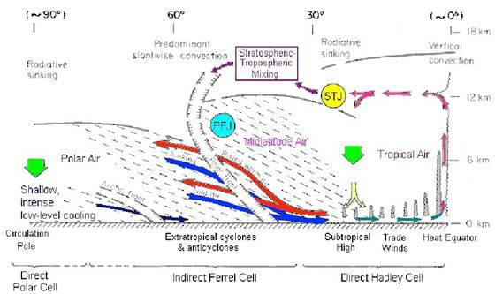
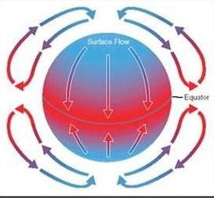
The Earth is spherical and rotates.
Rotation around the sun creates the seasons, but the rotation around the axes creates even bigger geophysical dynamic problems.
Because of it, a simple single cell system with heated air rising at the Equator moving to the Poles, sinking and returning to the Equator, breaks up.
The Coriolis Effect is the single biggest influence on the atmosphere caused by rotation. It dictates that anything moving across the surface appears to be deflected to the right in the Northern Hemisphere and to the left in the Southern Hemisphere.

Slide 48
A more Realistic View
Now it is the “Indirect Ferrell Cell”.
Notice the discontinuities in the Tropopause and the “Stratospheric – Tropospheric Mixing”.
This is important, because the IPCC doesn’t deal with the critical interface between the stratosphere and a major mechanism in
the upper Troposphere in their models.
Due to the computational cost associated with the requirement of a well-resolved stratosphere, the models employed for the
current assessment do not generally include the QBO.

Slide 49
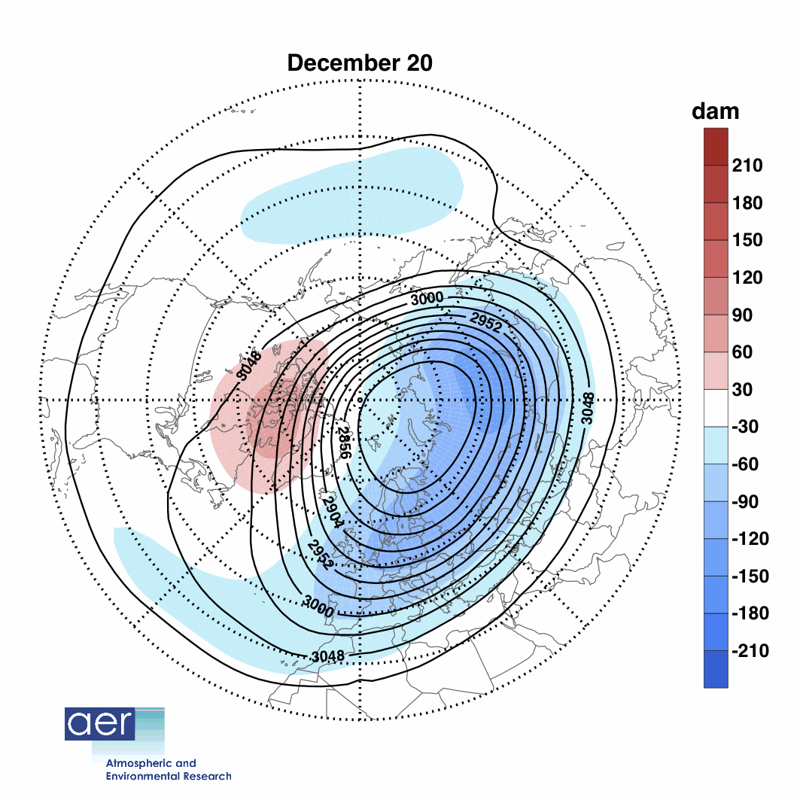
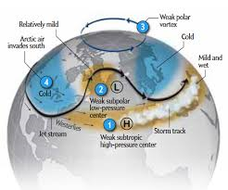
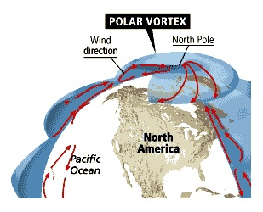
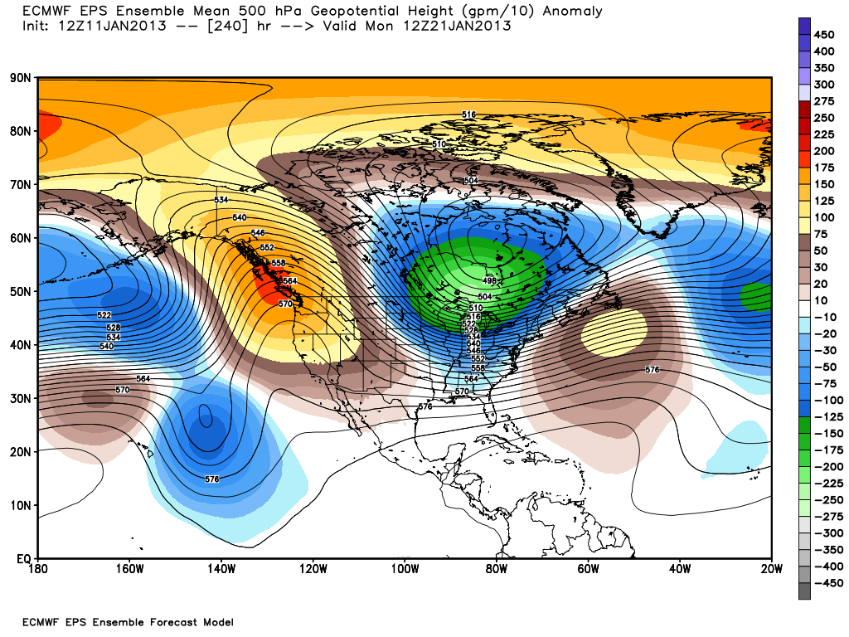
Polar Vortex

Slide 50
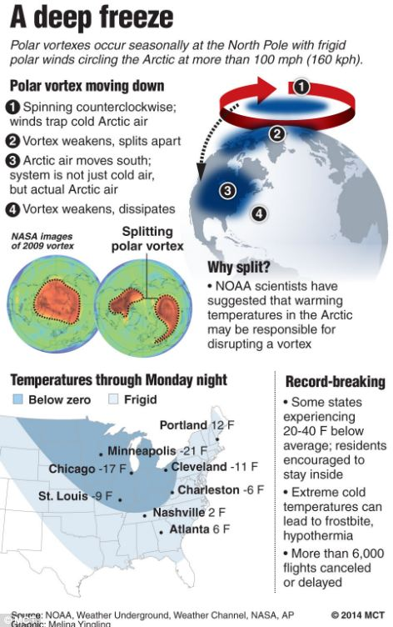
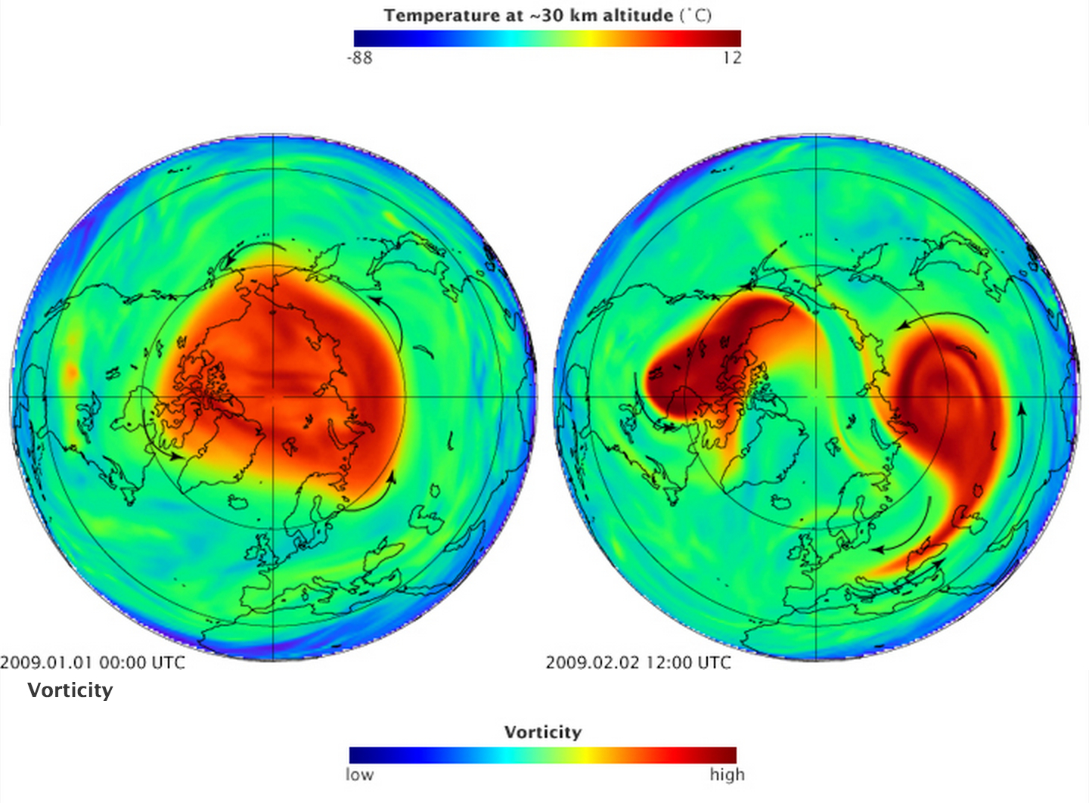
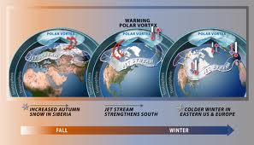

Slide 51
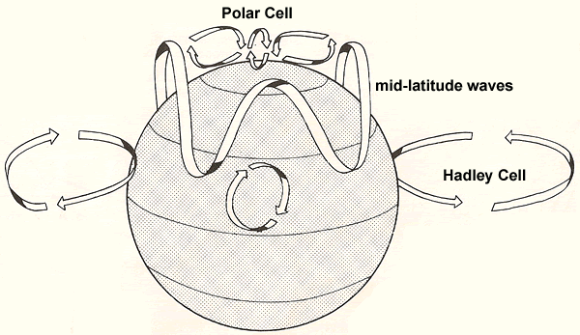

Slide 52


Sun, Stratosphere, Jet Stream, NAO & Climate

Slide 53
2.4 Underwater Volcanoes & ocean streams ?

Slide 54




Ocean & Under Water Volcanoes

Slide 55
The answer: structural analysis of a Complex system
“We accept any hypothesis except what is disproved”
(Aristote cited by Lord Mockton, Porto conference 2018)
(Popper)
Climate system (+ different theories)
Drivers & effects
Feedback loops
Power of a given « concept »

Slide 56
A meta-model considering…
Sun « dynamo » & fluctuating activity
Moon
Cosmic rays (Svenmark)
(Jovian)Planetary Gavitational forces
Electro-magnetic Fields (Sun, Earth & Planets)
Meteorites & asteroïd dust
(Under water) volcanoes)
Tectonic plates
Albedo
Radiative & convective heat transfer
Convective mass transfer
[… and CO2] ???

Slide 57
Cosmic Rays
Gravity
Moon Orbit
Meteorites
Muons
Gyroscopic Effect
Sun position (towards centre of
gravity of solar system)
& angular momentum
Earth orbital parameters
(position, rotation speed, position of the rotation axis; etc.)
Planet Conjunctions
Stresses in sun core
Tides
Oceanic
Currents (conveyor belt, halocline, etc.)
Stresses in
tectonic plates
Solar dynamo
Radiation Tuner
Solar magnetic field
Earth dynamo
=> magnetic shield
Surface
volcanoes
Submerged volcanoes
Solar Activity
Radiation Tuner
Clouds & Atmosphere Albedo & absorption
Clouds
Position & extend of ice caps
Radiative incoming flux
Atmosphere composition
Ocean
composition
Radiation Tuner
Feedback
loops
Feedback
loops
Ocean & Ice
caps Albedo
Atmosphere
T°
Soil Surface
T°
Heat & mass
Transfer
Biosphere
Soil Albedo
anthropogenic
Sea Surface
T°
Notes:
The reality of the climate system is much more complex and looks probably like shown on this sketch, according the present level of understanding. Interconnections between the “forcings is obvious and feedback loops can be identified. Also, each of the boxes is itself a rather complex sub-system, with many non linearities and time delays.

Slide 58


Are IPCC “experts”(?) serious ?
Can you reasonably reduce this
To this ?

Slide 59
What can we learn from Complex System Analysis?
Causal Concept
CO2 is not a CAUSE!!!!
Meteorites
Cosmic rays
Planetary Conjonctions + gravitational & electromagnetic forces
(Avec effet sur le rayonnement solaire, la couverture nuageuse, les plaques tectoniques, le volcanisme, etc. )
Relay Concept
CO2 & Temperature
Tuning Relay Concepts has unpredictable effects, due to many (in)direct time delayed positive and negative (stabilizing) feedback loops. (some of them are even probably unknown at this time.)
Effect Concept
Temperature
Is NOT an effect!!!
Further details on Complex Systems Analysis are given in Appendix

Slide 60
3- Local equilibrium & Navier-Stokes equations

Slide 61

How GCM models work
Global Circulation Models
The models start by dividing the atmosphere into a huge 3D grid of boxlike elements, with horizontal edges typically 100 kilometers long and up to 1 kilometer high. Equations based on physical laws describe how variables in each box—mainly pressure, temperature, humidity, and wind speed—influence matching variables in adjacent ones. For processes that operate at scales much smaller than the grid, such as cloud formation, scientists represent typical behavior across the grid element with deterministic formulas that they have refined over many years. The equations are then solved by crunching the whole grid in a supercomputer

Slide 62

Structure of GCM models
(Global Circulation Models)
An ENORMOUS number of time & space iterations required
Hyper-computers are required ($$$$$$)
Propagation of initial errors (value of local parameters) ???

Slide 63

IPCC Models
Equilibrium in each box
Navier-Stokes equations (incompressible fluid) between adjacent boxes
Runge-Kutta algorithm

Slide 64

Simulation of trends in US winter temperature over the period 1963-2012
Chaotic output
Indeed…

Slide 65
With the caption: “Winter temperature trends (in degrees Celsius) for North America between 1963 and 2012 for each of 30 members of the CESM Large Ensemble. The variations in warming and cooling in the 30 members illustrate the far-reaching effects of natural variability superimposed on human-induced climate change. The ensemble mean (EM; bottom, second image from right) averages out the natural variability, leaving only the warming trend attributed to human-caused climate change. The image at bottom right (OBS) shows actual observations from the same time period. By comparing the ensemble mean to the observations, the science team was able to parse how much of the warming over North America was due to natural variability and how much was due to human-caused climate change. Read the full study in the American Meteorological Society’s Journal of Climate. (© 2016 AMS.)”
The 30 North American winter projections were produced as part of the CESM-Large Ensemble project, running the same model 30 times with exactly the same parameters with the exception of a tiny difference in a single initial condition – “adjusting the global atmospheric temperature by less than one-trillionth of one degree”.
Mathematical models can hide chaos
Mathematical models can also create chaos

Slide 66
The answer: Locally the system is NOT in equilibrium
& chemical engineering process dynamics DO APPLY

Slide 67
A More Complex Reality
Système complexe avec échanges de chaleur et matière et boucles de rétroaction
avec retard

Slide 68
Heat & Mass Transfer at an Interface
IPCC
This approach
Local equilibrium reached
Cells linked by the Navier-Stokes Equations
Leading to
  Propagation of errors (cfr Michael Limburg presentation)
  Chaotic behaviour of the results of the models
System NOT in local equilibrium
H&M transfer equations
Coefficients estimated from empirical correlations between adimensional numbers (Reynolds, Nusselt, Prandl, Grashof, etc.)

Slide 69

Convective Mass Transfer Equation
$$\frac{dC_{i}}{dt}=mS\left(C_{i}−C_{i∗}\right)$$
_{Where :}
Ci = concentration of the component i (in the phase considered)
Ci* = gas-liquid equilibrium concentration (given by Henry or Raoult
law and depending on temperature as described by van t’Hoff
_{law)}
_{t = time}
m = mass transfer coefficient (given by an empirical correlation linking
adimensional numbers, depending on temperature)
_{S = exchange surface}

Slide 70

Convective Heat Transfer Equation
$$\frac{dT_{i}}{dt}=hS\left(T_{i}−T_{j}\right)$$
_{Where :}
Ti = temperature in phase I (ocean or atmosphere)
Tj = temperature in phase j (the other phase)
_{t = time}
h = heat transfer coefficient (given by an empirical correlation linking
adimensional numbers, depending on temperature)
_{S= exchange surface}

Slide 71


Inclusion of Radiative Heat Transfer
$$\frac{dT_{i}}{dt}=\left(h+h_{r}\right)S\left(T_{i}−T_{j}\right)$$
$$where : h_{r}=σε_{s}\left(4T_{s}^{3}\right)$$
(See appendix for details)
If (Ti-Tj) is more than a few degrees C, use instead of T_{s} , (T_{i} + T_{j})/2
Equation (6) is only valid for a small surface completely surrounded by a surface of much larger area (so, only the emissivity of the small surface influences the radiative heat flux).
If the surfaces are of same area, the term ε_{s} will be replaced by:
$$\frac{1}{\left[\left(\frac{1}{ε_{1}}\right)+\left(\frac{1}{ε_{2}}\right)−1\right]}$$

Slide 72










Perfect Mixers & Plug Flows
F
C_{i}
V
F
V
F
C_{i}
C_{o}
$$∞∞$$
F
$$C_{o}\left(t\right)= C_{i}\left(t−τ\right)$$
$$C_{o}=C_{i}e^{−\frac{t}{τ}}$$
C_{o}
Time-delay
$$τ= \frac{V}{F}$$
$$τ= \frac{V}{F}$$
V_{i}
V_{i}
---
V_{i}
---
V_{i}
V_{i}
$$∞∞$$
$$∞∞$$
$$∞∞$$
$$∞∞$$
$$∞∞$$
Equivalent to
V= Σ V_{i}

Slide 73








A simplified « climate » dynamical model
V
V
V
$$∞∞$$
$$∞∞$$
V
V
V
$$∞∞$$
$$∞∞$$
Atmosphere
Ocean
V
V
V
$$∞∞$$
$$∞∞$$
V
V
V
$$∞∞$$
$$∞∞$$

Slide 74


More
Sophisitcation…
TO SPACE
Geological
Sink & Source
Biological
Sink & Source
V
$$∞∞$$
Dead zones

Slide 75
Computing Details…
TRANSITION
MATRIX
X
=
Initial
State Vector
Final
State Vector
State vector: concentrations, temperature, pressure (pH), etc. in all the vessels
Transition matrix: changes happening during Δt
Plug flow reactors induce time delayed equations (use previous initial state vectors)

Slide 76

Thank you

Slide 77
Some Useful Books to enter my WORLD
Non linear Time series analysis
  Chaos and time series analysis, Sprotz
  Non linear time series analysis, Kantz & Shreiber
  Chaos in real data, Joe N Perry & all.
  Chaos detection and predictability, Charalampos & all
Complex system analysis
  Seeing the forest for the trees, Denis Sherwood
  Networks, J Newman
  Social network analysis, S Wasserman & K. Faust
  Strategic modelling & business dynamics, John D Morecroft
  Business dynamics, John D Sterman
Causality
  Causality, Josuah Pearl
RTD
  Tracer technology, Levenspiel

Slide 78
APPENDIXES

Slide 79
Matrix multiplication

Slide 80
Matrix Multiplication (recall)
Column j
x
=
Row i
Column j
Row i
a_{ij}
a_{ij} = Σ_{k} a_{ik}*a_{kj}

Slide 81
Example Matrix Multiplication
0 | 1 | 0
1 | 0 | 1
1 | 0 | 0
0 | 1 | 0
1 | 0 | 1
1 | 0 | 0
1 | 0 | 1
1 | 1 | 0
0 | 1 | 0
x
=
A
x
=
C (A² in this case)
B (=A in this case)
C₂₃ = a₂₁*b₁₃ + a₂₂*b₂₃ + a₂₃*b₃₃
C₂₃ = 1*0 + 0*1 + 1*0
C₂₃ = 0
C_{ij} = Σ_{k} a_{ik}*b_{kj}

Slide 82
Complex system analysis

Slide 83
Link with Causal Maps
Causes (driving variables)
Effects (dependent variables)
Relays : unstable & unpredictable
C_{a}
E_{m}
C_{b}
V_{m}
E_{n}
C_{c}
V_{q}
V_{p}
E_{o}

Slide 84


From Causal Map to Matrix

Slide 85


$$Driving F_{r}=\frac{1}{\left(N−1\right)} \sum_{r=1}^{N}{\left|a_{rc}\right|}$$
$$Depend. I_{c}=\frac{1}{\left(N−1\right)} \sum_{c=1}^{N}{\left|a_{rc}\right|}$$
$${Supporting I}_{r}=\frac{1}{\left(N−1\right)} \sum_{r=1}^{N}{a_{rc}}$$

Slide 86
Interaction Graph
1
Driving force index
Driving variables
Relay variables
Autonomous variables
Dependent variables
1
0
Dependence index

Slide 87
Higher Order Boolean Matrixes
& link to System Structure Analysis
A² matrix (squared)
a_{ij} = Σ_{k} a_{ik}*a_{kj}
  Can only be different of zero if one a_{ik} and the corresponding a_{kj} are different from zero
  Detects between i and j through one of the k other variables
a_{ij} = number of indirect links (wit one intermediate step) existing between i and j
a _{ii} = number of feedback loops (with one intermediate step….fast feedback)

Slide 88
Higher Order Boolean Matrixes
& link to System Structure Analysis (ctnd)
A³= same analysis but with 2 intermediate steps
A^{n} = same with (n-1) intermediate steps
Number of links increases with order of matrix
Sum of line = number of arrows leaving a variable
Sum of column = number of arrows arriving at a variable
Variables can be ranked according to these numbers
ranking stabilized after a few multiplications
=> longer term & indirect
  Causes
  effects
  and relay variables

Slide 89
Multiplying further the Matrixes
V_{i}
V_{j}
a_{ij} in A = 1
V_{i}
V_{m}
V_{j}
a_{ij} in A² = 1
V_{i}
V_{q}
V_{p}
V_{j}
a_{ij} in A³ = 1
V_{i}
V_{i}
a_{ii} in A = always 0
V_{i}
V_{m}
a_{ii} in A² = 1
V_{i}
V_{q}
V_{p}
a_{ii} in A³ = 1

Slide 90
(Long Term) Classification based on (stabilized) Ranking of sums of lines & columns
 |  |  | Rank of Rows
 |  |  | Good | Bad
 |  |  | 1 2 3 | n-2 n-1 n
Rank of columns | Good | 1 2 3 | Challenges | Effects
 | Bad | n-2 n-1 n | Causes
@ Copyrights Henri A. MASSON

Slide 91
Power of a “Concept”
Power = (Proximity Index)_{i} * (DF_{i} /Σ_{i}DF_{i})* (DF_{i}/(DF_{i}+Dep_{i})
Why not
Driving force / dependence ratio ?
Ratio is not normed
=> infinite if dependence = 0
Position on
communication lines ?
Driving force
Σ_{c}
Σ_{l}Σ_{c}
Dependence

Slide 92
Proximity Index
The proximity index of a given “concept” measures the extend of control on interactions ( and information exchange) between the other “concepts”.(often applied when the “concepts” are stakeholders acting in and around an Organization)
How closer to 1, how higher the level of control (central position for a “star” configuration of an Organization)
How closer to 0, how greater the “exclusion” of the “concept” (bottom line from a strict “tree” hierarchical model of Organization)
A too high level of control may however lead to a saturation in information. For large Organizations some delegation and some filtering of information reaching the “central & top “ manager are best recommended.

Slide 93
Proximity Index
(Example)
E
B
Proximity index for A:
1 (to D) + 1(to F) +2 (to C) +2 (to B) + 3 (to E) = 9
Normalized : (n-1) /9 = 5/9 = 0,55
F
C
Proximity index for E:
1 (to B) +2(to F) +3 (to C) +3 (to D) + 3 (to A) = 12
Normalized : (n-1) /12 = 5/12 = 0,42
D
A
Proximity index for F:
1 (to B) + 2(to E) +1 (to C) +1 (to D) + 1 (to A) = 6
Normalized : (n-1) /6 = 5/6 = 0,83

Slide 94
Proximity Index
(Star Configuration)
E
Proximity index for F:
1 (to A) + 1(to B) +1 (to C) +1 (to D) + 1 (to E) = 5
Normalized : (n-1) /5 = 5/5 = 1
B
F
C
Proximity index for D:
2 (to A) + 2(to B) +2 (to C) +1 (to F) + 2 (to E) = 9
Normalized : (n-1) /9 = 5/9 = 0.55
D
A

Slide 95
Proximity Index
(Star + Ring)
J
K
Proximity index for F:
1 (to A) + 1(to B) +1 (to C) +2 (to D) + 1 (to E) +2 (to G)+2 (to H)+2(to I)+2 (to J)+2(to K) = 16
Normalized : (n-1) /16 = 10/16 = 0.62
E
B
Proximity index for A:
2(to B) +2(to C) +3 (to D) + 2 (to E) + 1 (to F) + 1 (to G)+1 (to H)+1(to I)+3 (to J)+3(to K) = 16
Normalized : (n-1) /16 = 10/16 = 0,62
F
C
A
D
G
H
I
Proximity index for D:
3(to A)+3(to B)+1(to C)+3 (to E)+2(to F) +4 (to G)+4(to H)+ 4(to I)+ 4(to J)+4(to K) = 32
Normalized : (n-1) /32 = 10/32 = 0,31

Slide 96
Proximity Index
(Extensive Pyramidal)
A
Proximity index for A:
1(to B)+1(to C)+1(to D)+ 2(to E)+3(to F)+2(to G)+2(to H)+3(to I)+3 (to J)+4(to K) = 22
Normalized : (n-1) /22 = 10/22 = 0.45
B
C
D
Proximity index for C:
1(to A)+2(to B)+2 (to D)+1(to E)+2(to F) + 3(to G)+3(to H)+4(to I)+4(to J)+5(to K) = 27
Normalized : (n-1) /27 = 10/27 = 0,37
E
H
F
G
I
J
Proximity index for K:
4(to A)+5(to B)+5(to C) )+3(to D)+6(to E)+7(to F)+2(to G)+6(to H)+3(to I)+1(to J = 42
Normalized : (n-1) /42 = 10/42 = 0,24
K

Slide 97
Finding the Proximity Index from Boolean Matrixes
Explore each line i of A, A², A³…. successively
For each j, detect the first matrix in which a_{ij} is non zero
The order of the corresponding A^{K} matrix gives k, the number of steps needed to go from i to j
Sum up for all j
PI = (n-1) /Σ_{j}
Example (matrix A, A²…)
n = 3 (a, b and c)
From a to b : 1
From a to c : 2
(PI)_{a} = (3-1) /(1+2) = 2/3 = 0.66
From b to a: 1
From b to c : 1
(PI)_{b} = (3-1) /(1+1) = 2/2 = 1
a b c
a b c
a
b
c
a
b
c
0 | 1 | 0
1 | 0 | 1
1 | 0 | 0
1 | 0 | 1
1 | 1 | 0
0 | 1 | 0
A
A²

Slide 98
Further Developments
Factor Analysis of Correspondences
  “Reducing” the variables
  Build the covariance matrix
  Find eigen values
  Calculate eigen vectors in dual spaces (rows & columns as dependent variables)
  Adapt the “modules” of eigen vectors
  Superpose the two spaces on a same graph
  => Causes and effects are on the same graph, their proximity describing the strength of the link.

Slide 99
Utility of Structural Analysis
A way to structure complexity
A systematic approach to problem analysis
A common language and visualization in the group
Feedback loops are identified leading to (un-) stability assessment
Ranking of variables according to their power
Identification of causes, effects, relays…..clusters
Link with graph theory = input to statistical analysis (partial correlations, factors….)

Slide 100
Limits of Structural Analysis
List of variable is subjective (importance of group contribution & consensus)
Practical limit: 20 – 30 variables => clustering of variables for convenience
Subjectivity (non robustness) of the filling in of the matrix: a system is not the reality but the way you look at it
80 % of outcomes are obvious => worthwhile the effort? (yes…gives credibility to 20% outcomes that are surprising, unexpected….)

Slide 101
Combining convective & radiative heat transfer

Slide 102
What about Radiative Heat Transfer ?
Combined heat transfer by conduction-convection and radiation
(after Mc Cabe, Smith & Harriott,Unit Operations of Chemical Engineering, pg 422 (1993))
Since the two types of heat transfer happen in parallel, per unit of exchange surface A, the fluxes are given by:
Where:
Q_{t} = total heat transfer flux [watt]
Q_{c} = conductive-convective heat transfer flux [watt]
Q_{r} = radiative heat transfer flux [watt]
A = exchange surface [m²]
h_{c} = convective heat transfer coefficient [watt/(m²°C)]
T_{s} = surface temperature [°K]
T = fluid temperature [°K]
s = Stephan-Boltzmann constant (5.67 10⁻⁸ W/m²K⁴ )
e_{s} = surface emissivity [0]

Slide 103



What about Radiative Heat Transfer (ctnd) ?
Which can be rewritten as:
Where h_{r} refers to the radiation heat transfer coefficient, defined as
This coefficient depends strongly on T_{s} and to some extend on the temperature difference (T_{s}-T)
However when the temperature diference is small, the value of h_{r} can be approximated from a simple equation using only one temperature.
The fourth power term of equation (1) can be expanded as:
If T_{s} – T is small, T can be replaced by T_{s} in all terms of the product on the right side of equation (4), except the last one, to give
From the definition of h_{r}
If (T_{s}-T) is more than a few degrees but less than 20% of T_{s}, one can use (T_{s}+T)/2 instead of T_{s} in equation (6), to improve its accuracy.
Equations (1) and (6) are valid for a small area completely surrounded by a surface of much larger area, so that only the emissivity of the small area influences the radiative heat flux.
If the surfaces are of same area, the term e_{s} will be replaced by

Slide 104
Sensibility Analysis for hr/(hc + hr)

